Slide 1

3D Modeling of Neurons and Bones
Vy-Linh Gale, Xinyi Susan Xu, Maria Dooling

Slide 2
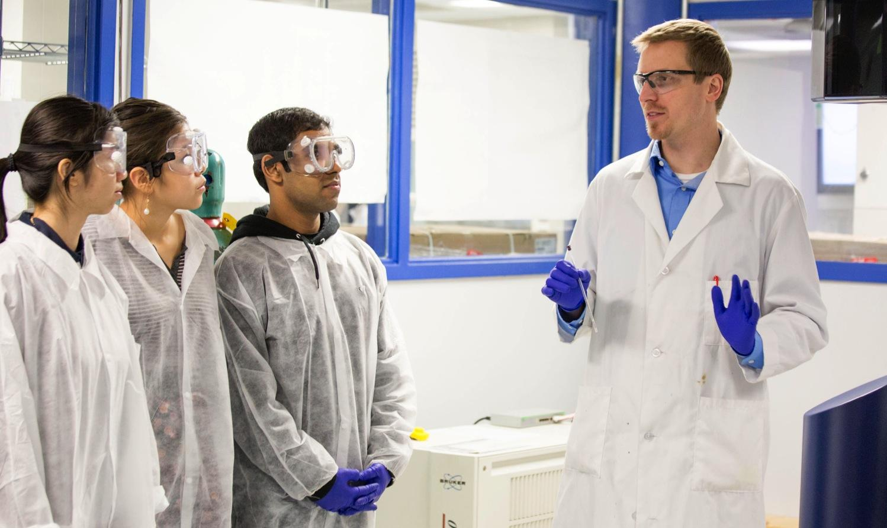
Overview
Objectives
Background
Neurons
What has been done
Issues
Future Goals
Bones
Progress Made
Remaining Tasks

Slide 3
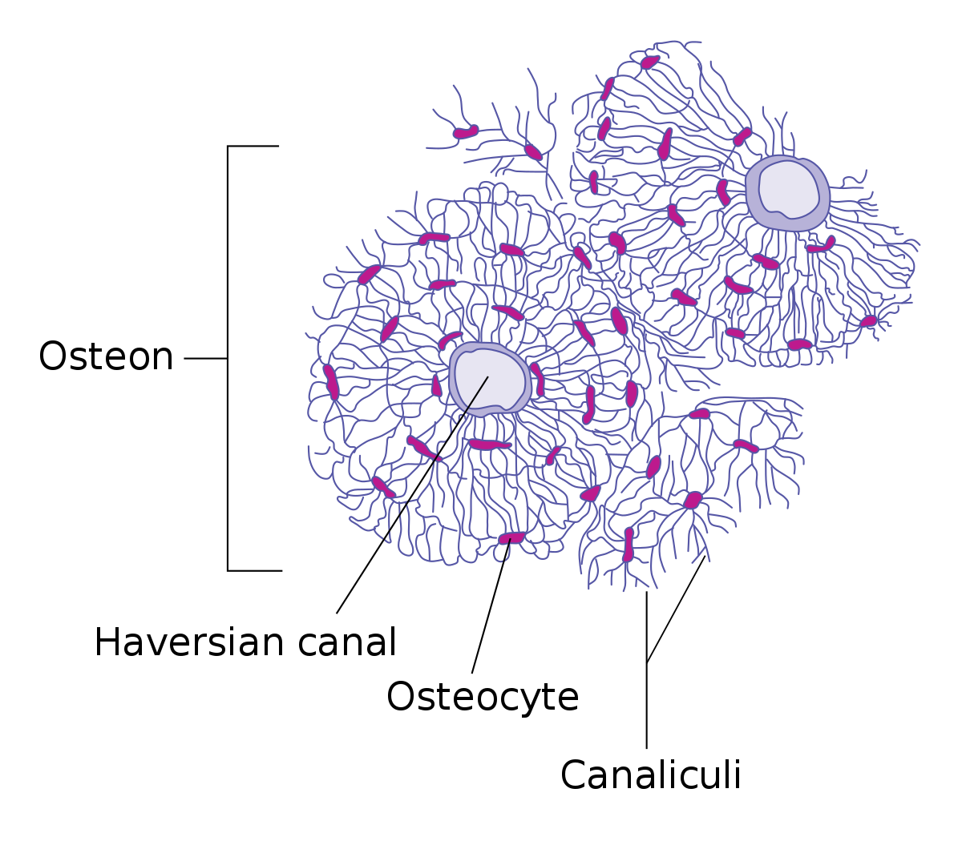
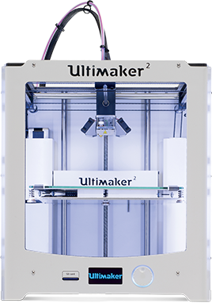
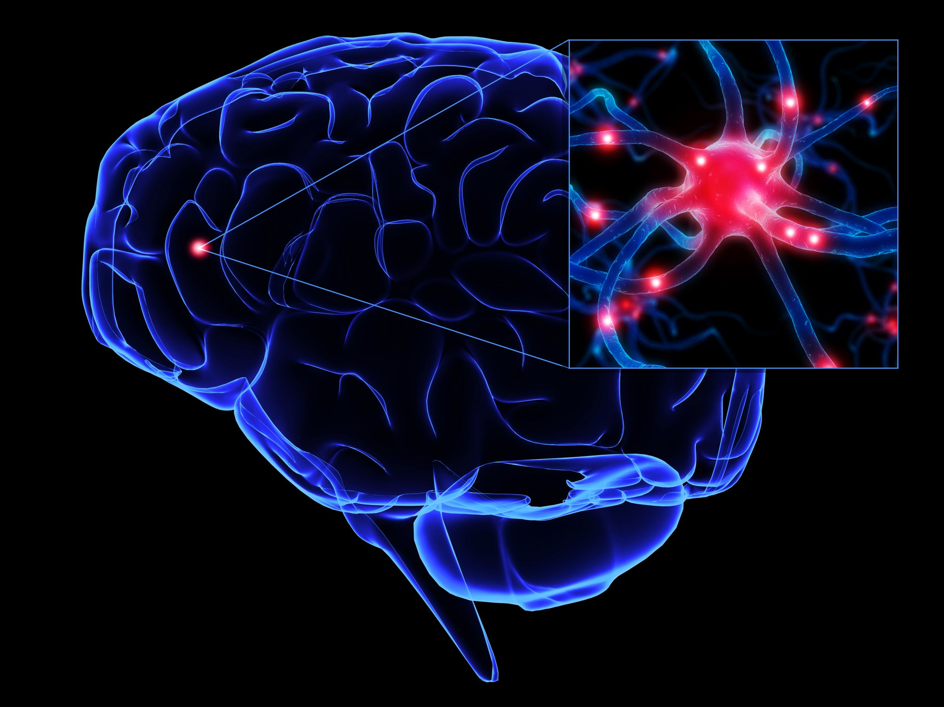
Objectives
Learn about the structure of neurons and bones
Determine dimensions of scaled models of neurons and bones
Design neurons with synapses that can interconnect
Create 3D bone which clearly show structure of osteons and osteocytes
Learn how to use 3D printers and laser cutters

Slide 4
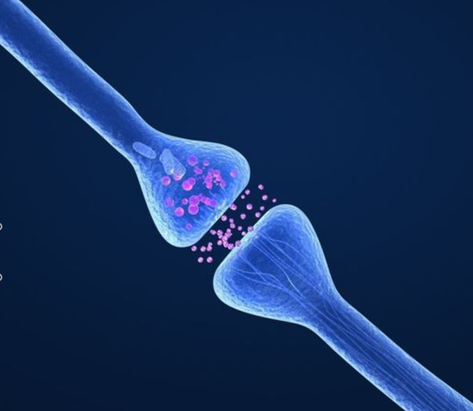
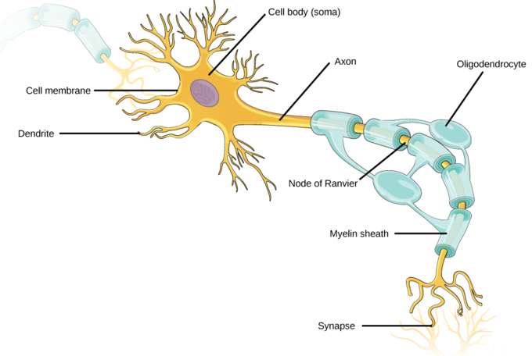
Background- Neurons
General Structure of the Neuron
Soma
Dendrites
Axons
Synapses
Issues With Existing Models
2D representations
Singularly synapsed
No spatial orientation
Oversimplified
Notes:
The insulating envelope of myelin that surrounds the core of a nerve fiber or axon and that facilitates the transmission of nerve impulses

Slide 5
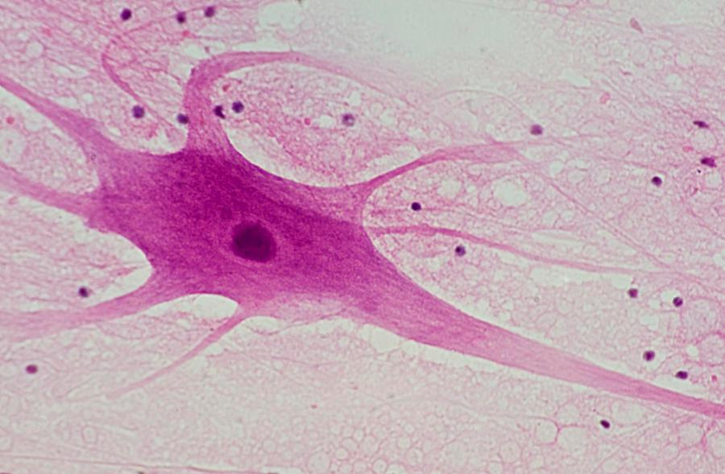
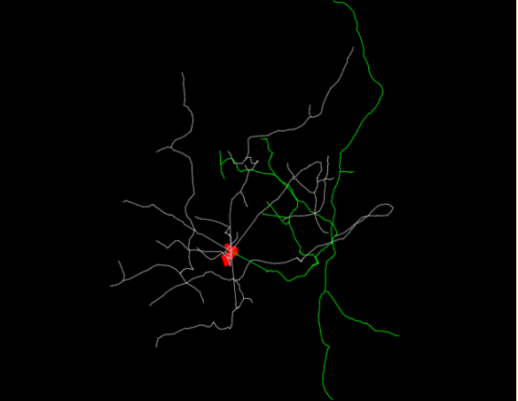
Neurons cont.
Purpose for Printing
Students can visibly see how neurons synapse
Understand how different neurons vary
Understand general structure

Slide 6
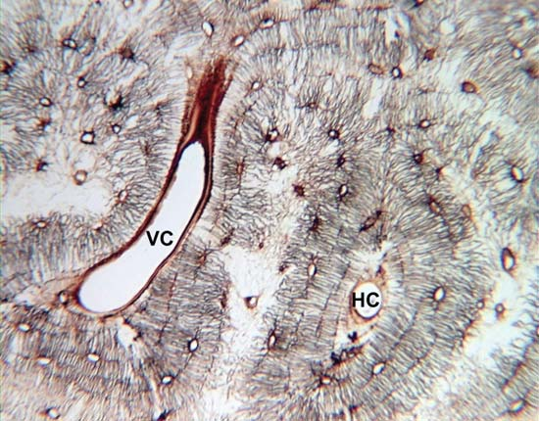
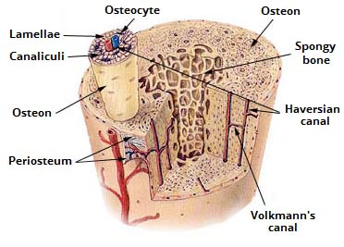
Background- Bones
Understand the composition of bones
Bone → osteon → osteocyte
Issues with existing bone models
Static
Difficult to understand connection between substructures
Notes:
Volkmann canals connect adjacent osteons and also connect the blood vessels of the Haversian canals with the periosteum, the tissue covering the bone’s outer surface.

Slide 7
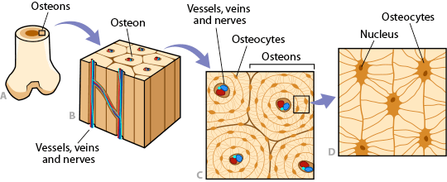
Bones cont.
Issues encountered when designing new bone model

Slide 8
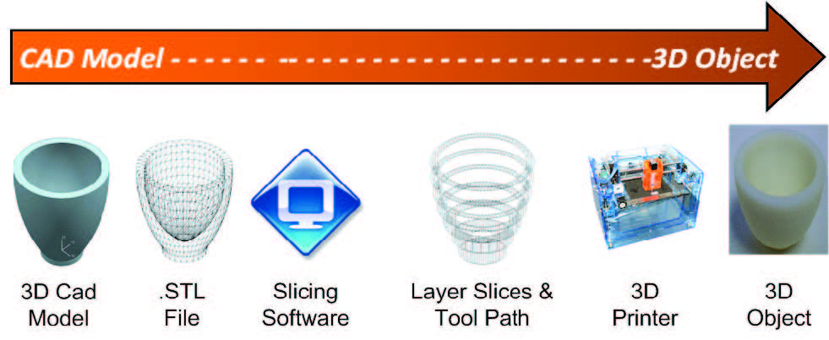
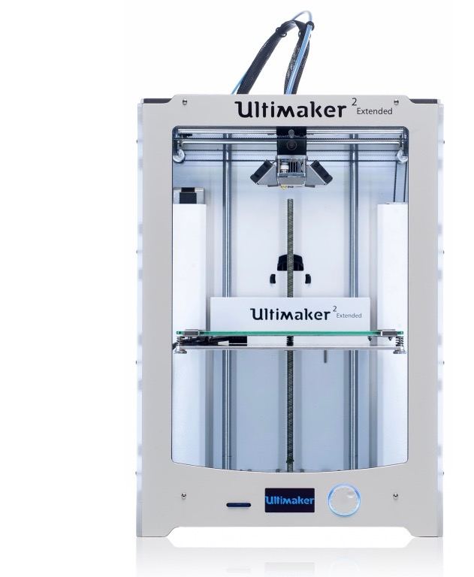
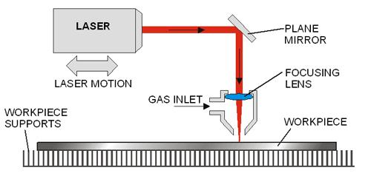
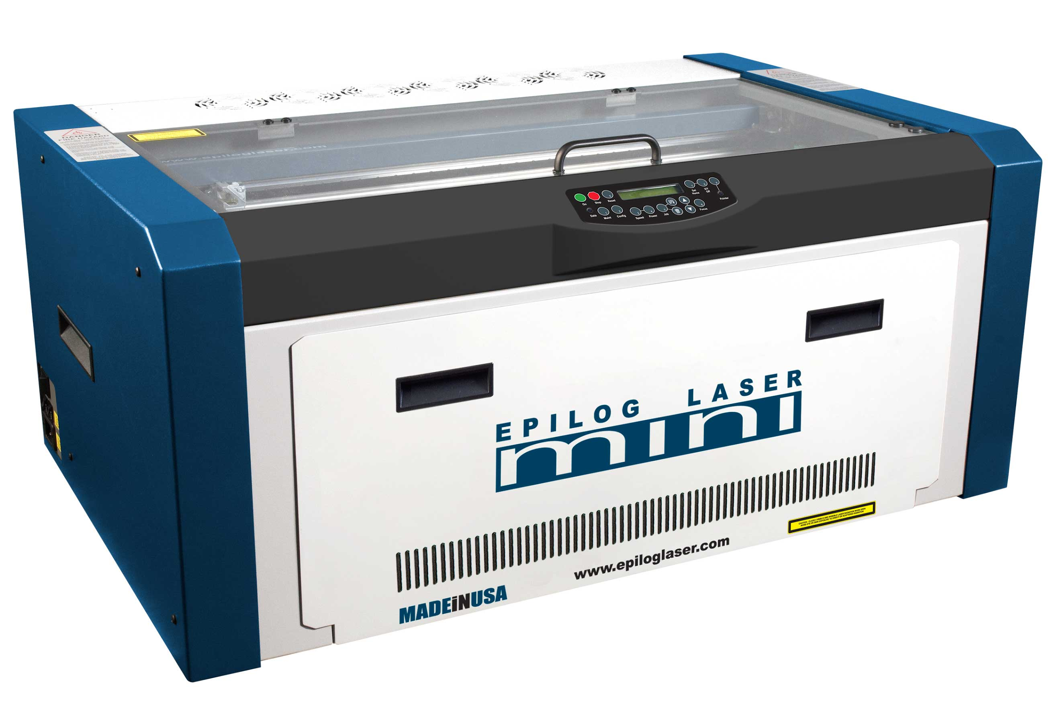
Background- 3D Printers and Laser Cutters
3D printing
File converting
Layers, supports, base
Print
Laser Cutting
Image
Laser file
Cutting or engraving

Slide 9
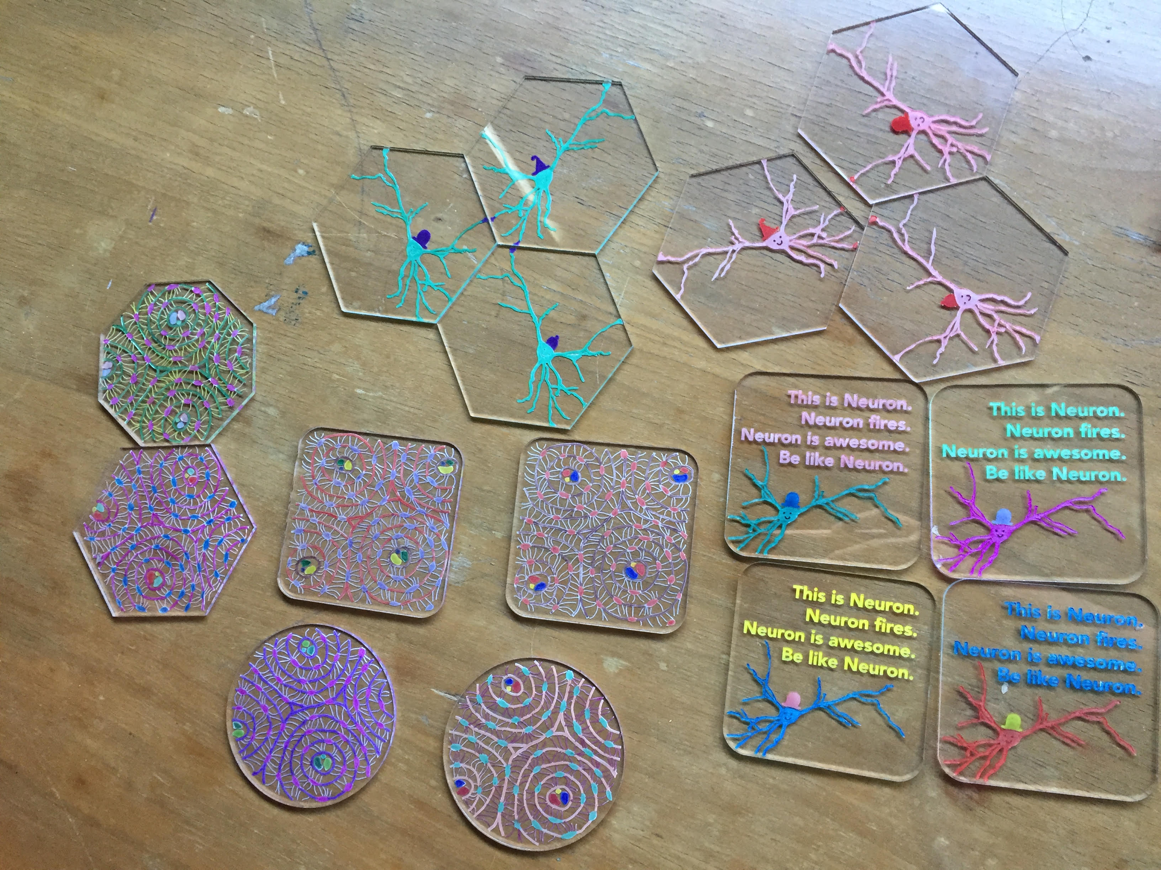
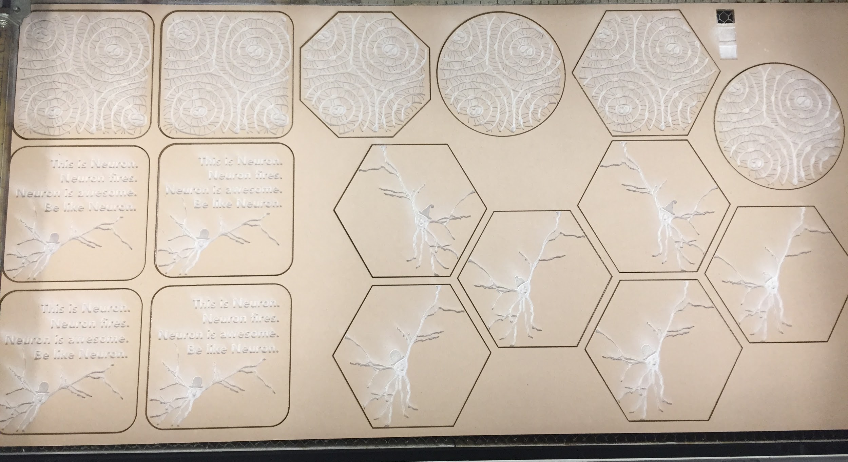
Neurons
Progress Made
Fun coasters
Laser cut
For sale

Slide 10
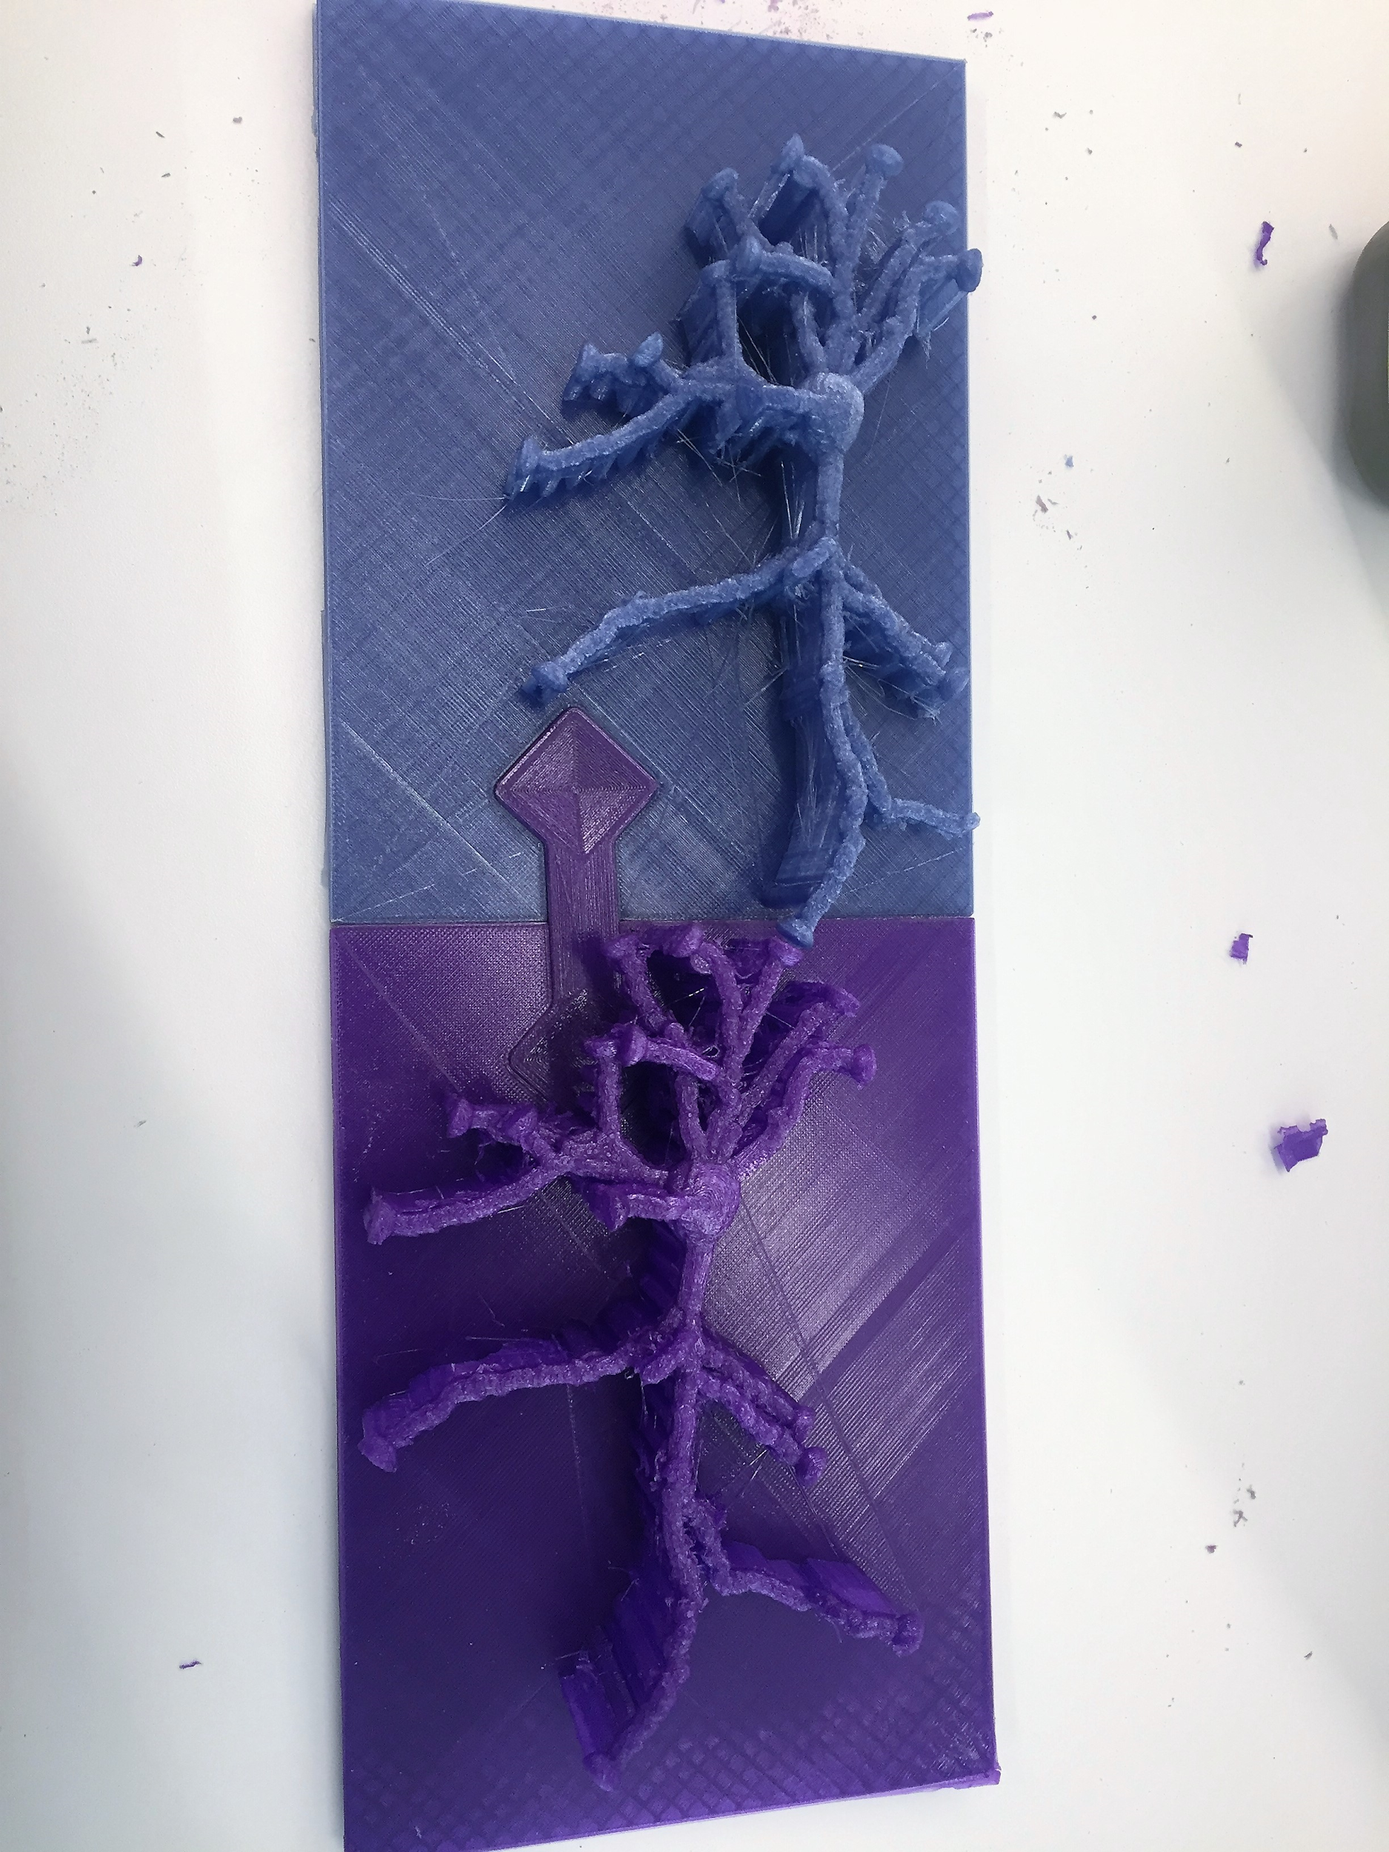
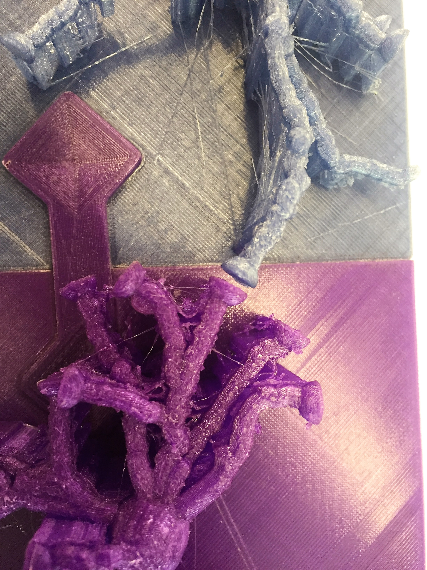
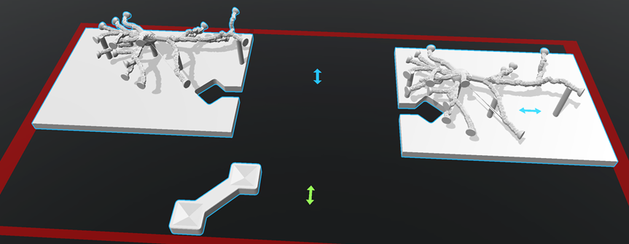
Neurons
What’s Been Done
Printing synapses
Puzzle piece bases
Gap between represented
Possible synapse representation
Notes:
The neuron with correct ends was not enough to show synapsing
Needed a way to connect them together without touching the ends of the dendrites because synapses are actually just spaces between two neurons
Developed a structure that acted as a base for the neurons but also had a puzzle-like component to them in order for them to fit perfectly together so that a synapse could be shown properly

Slide 11
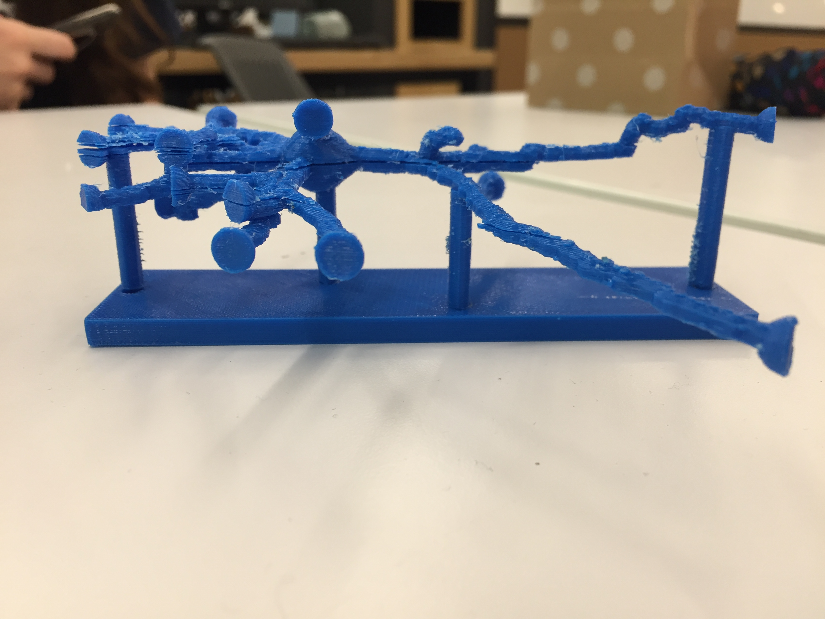
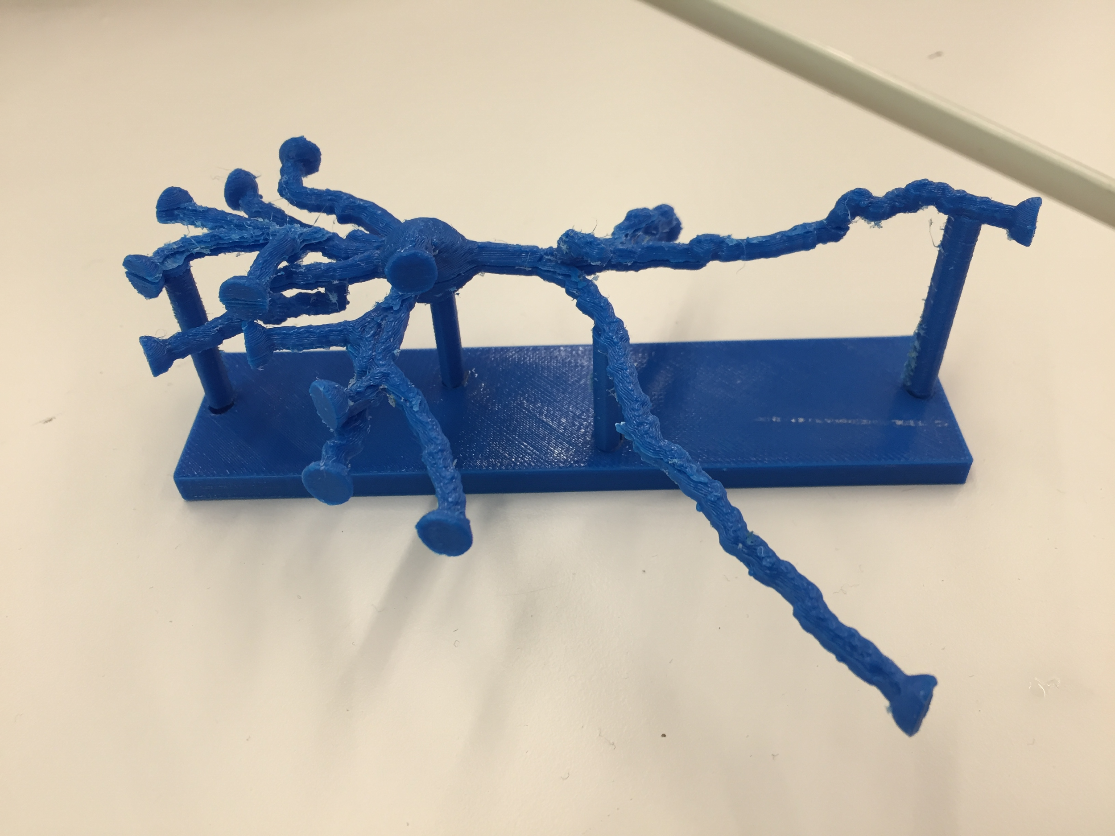
Neurons
What’s Been Done
Print Testing
MOJO Printer
No supports
Neuron with smaller base printed

Slide 12
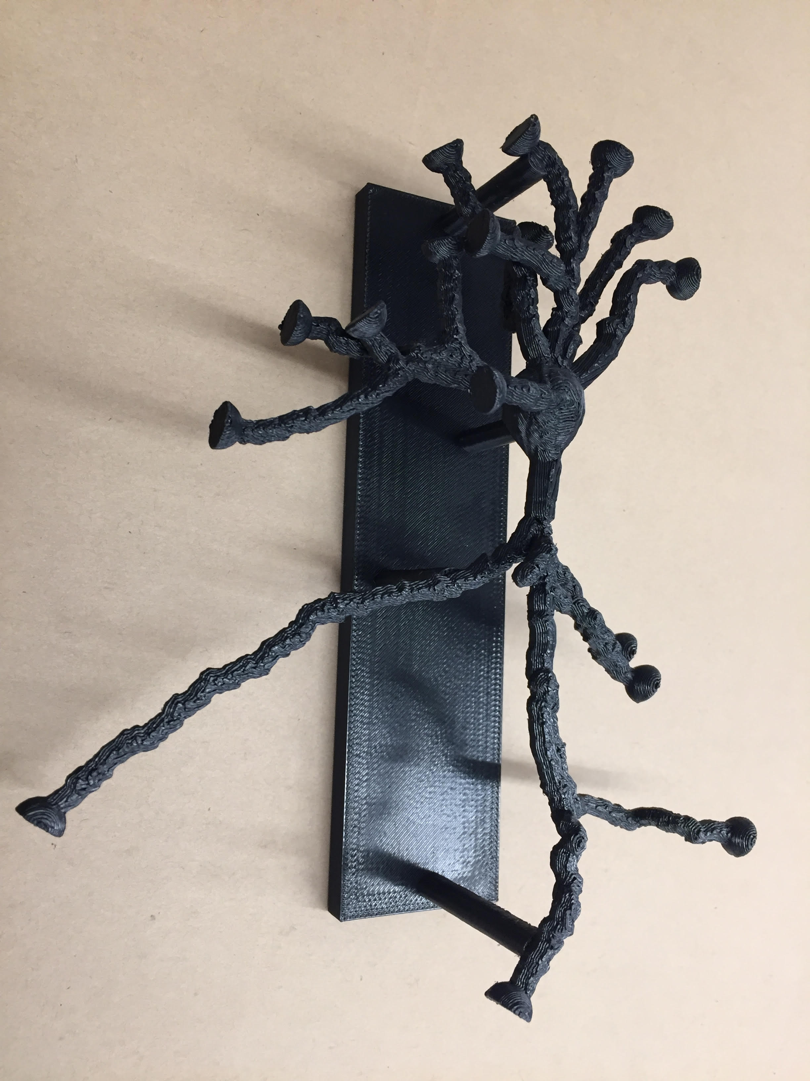
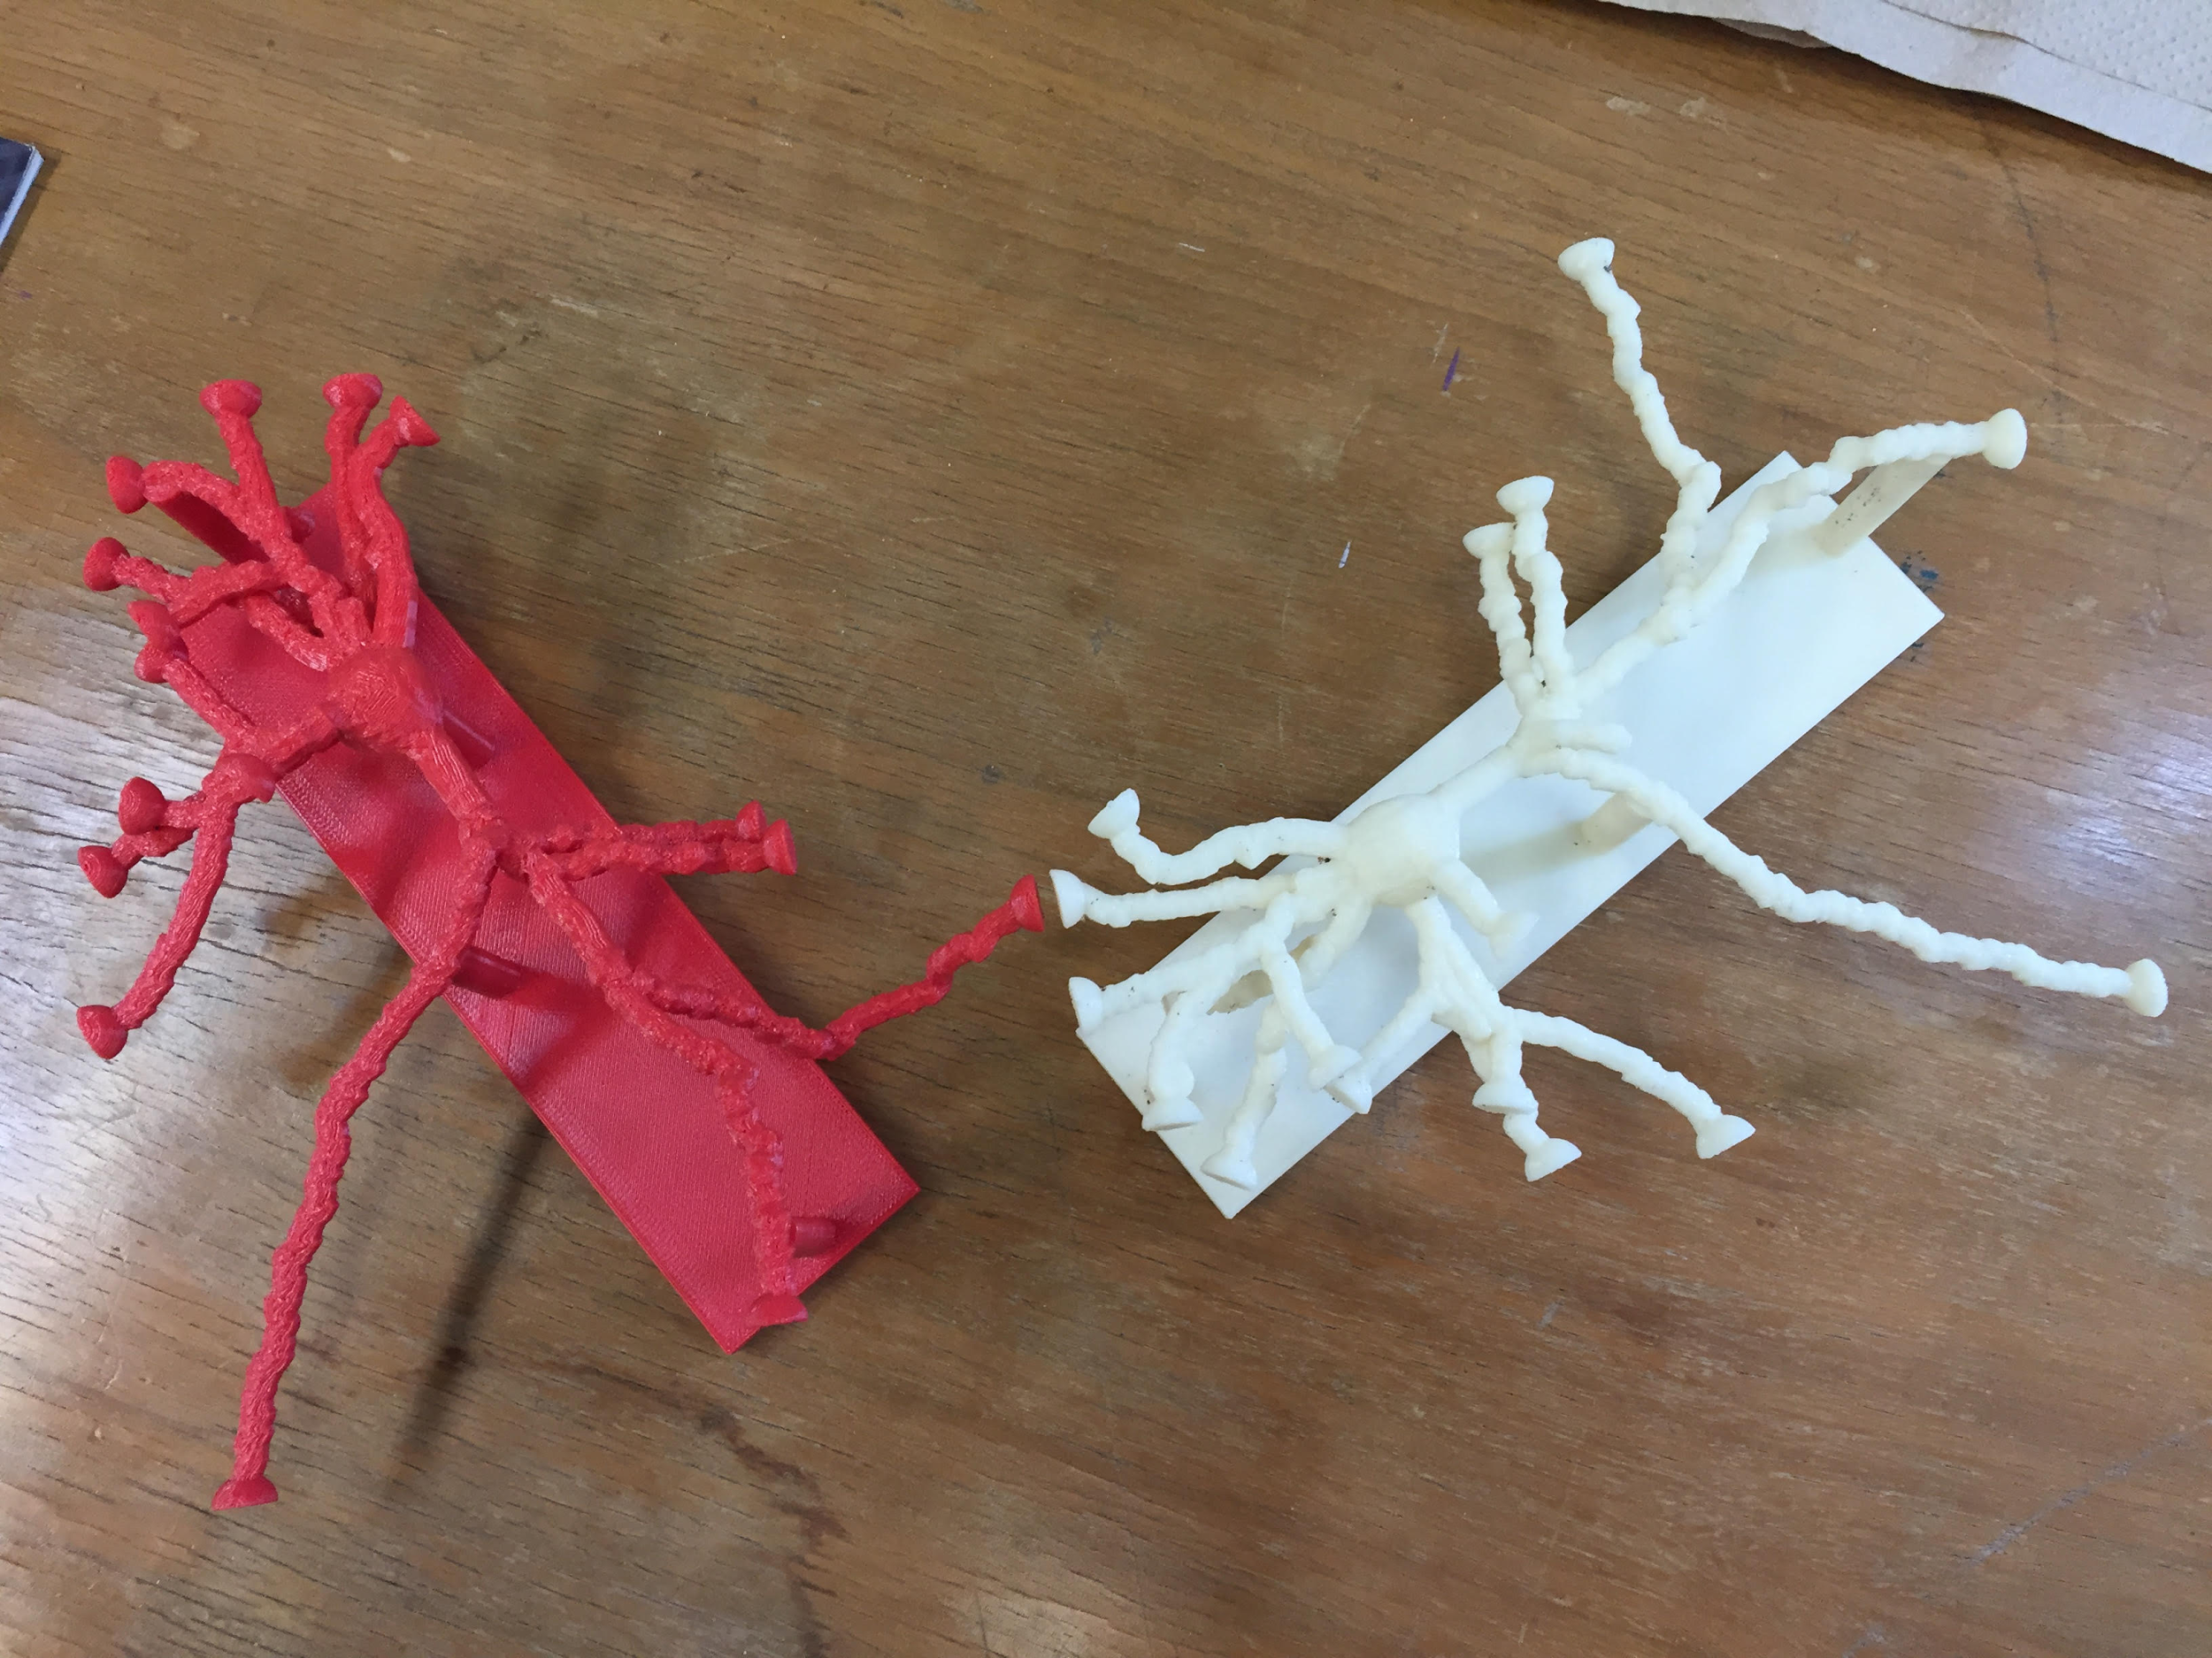
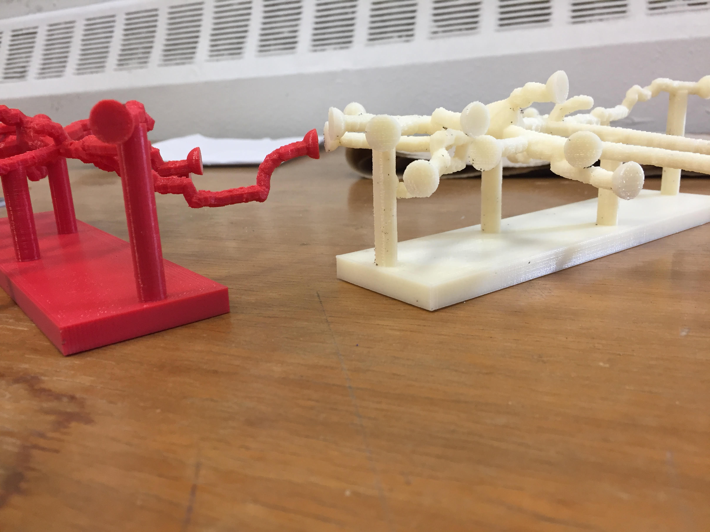
Neurons
What’s Been Done
Final Print
Elite Printer
No supports
Larger
Elite Neuron Prints

Slide 13
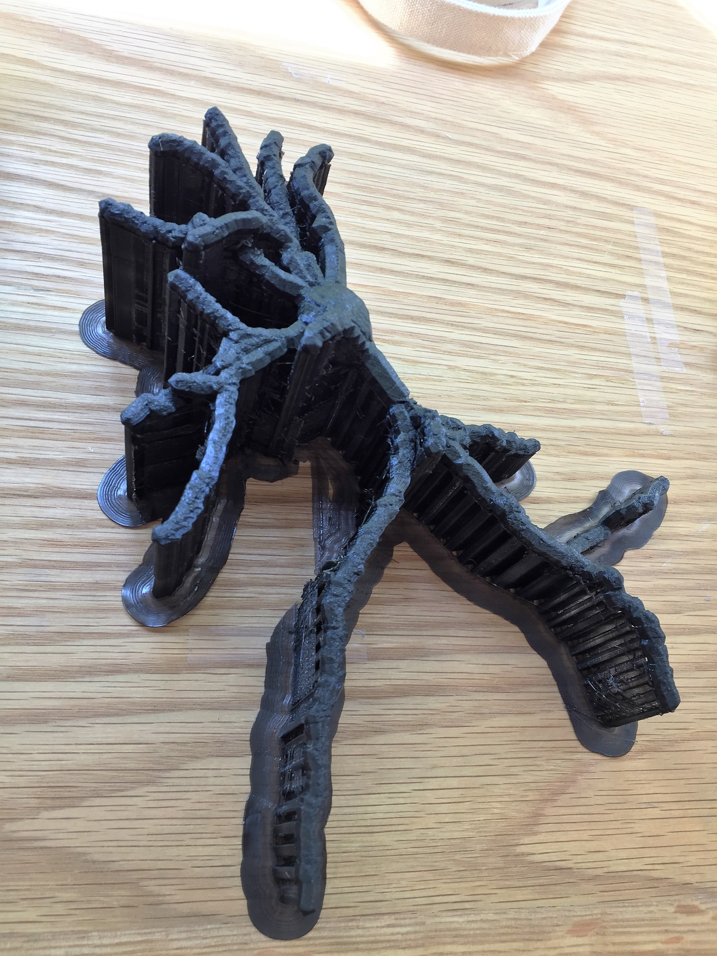
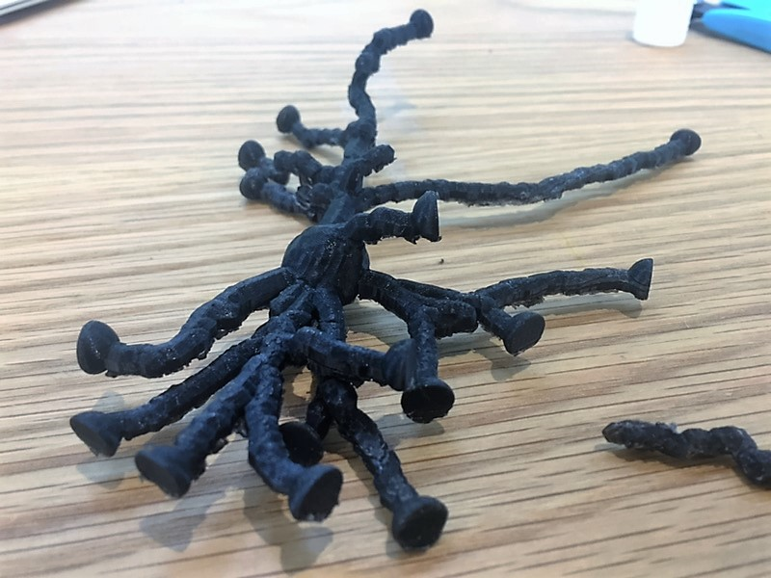
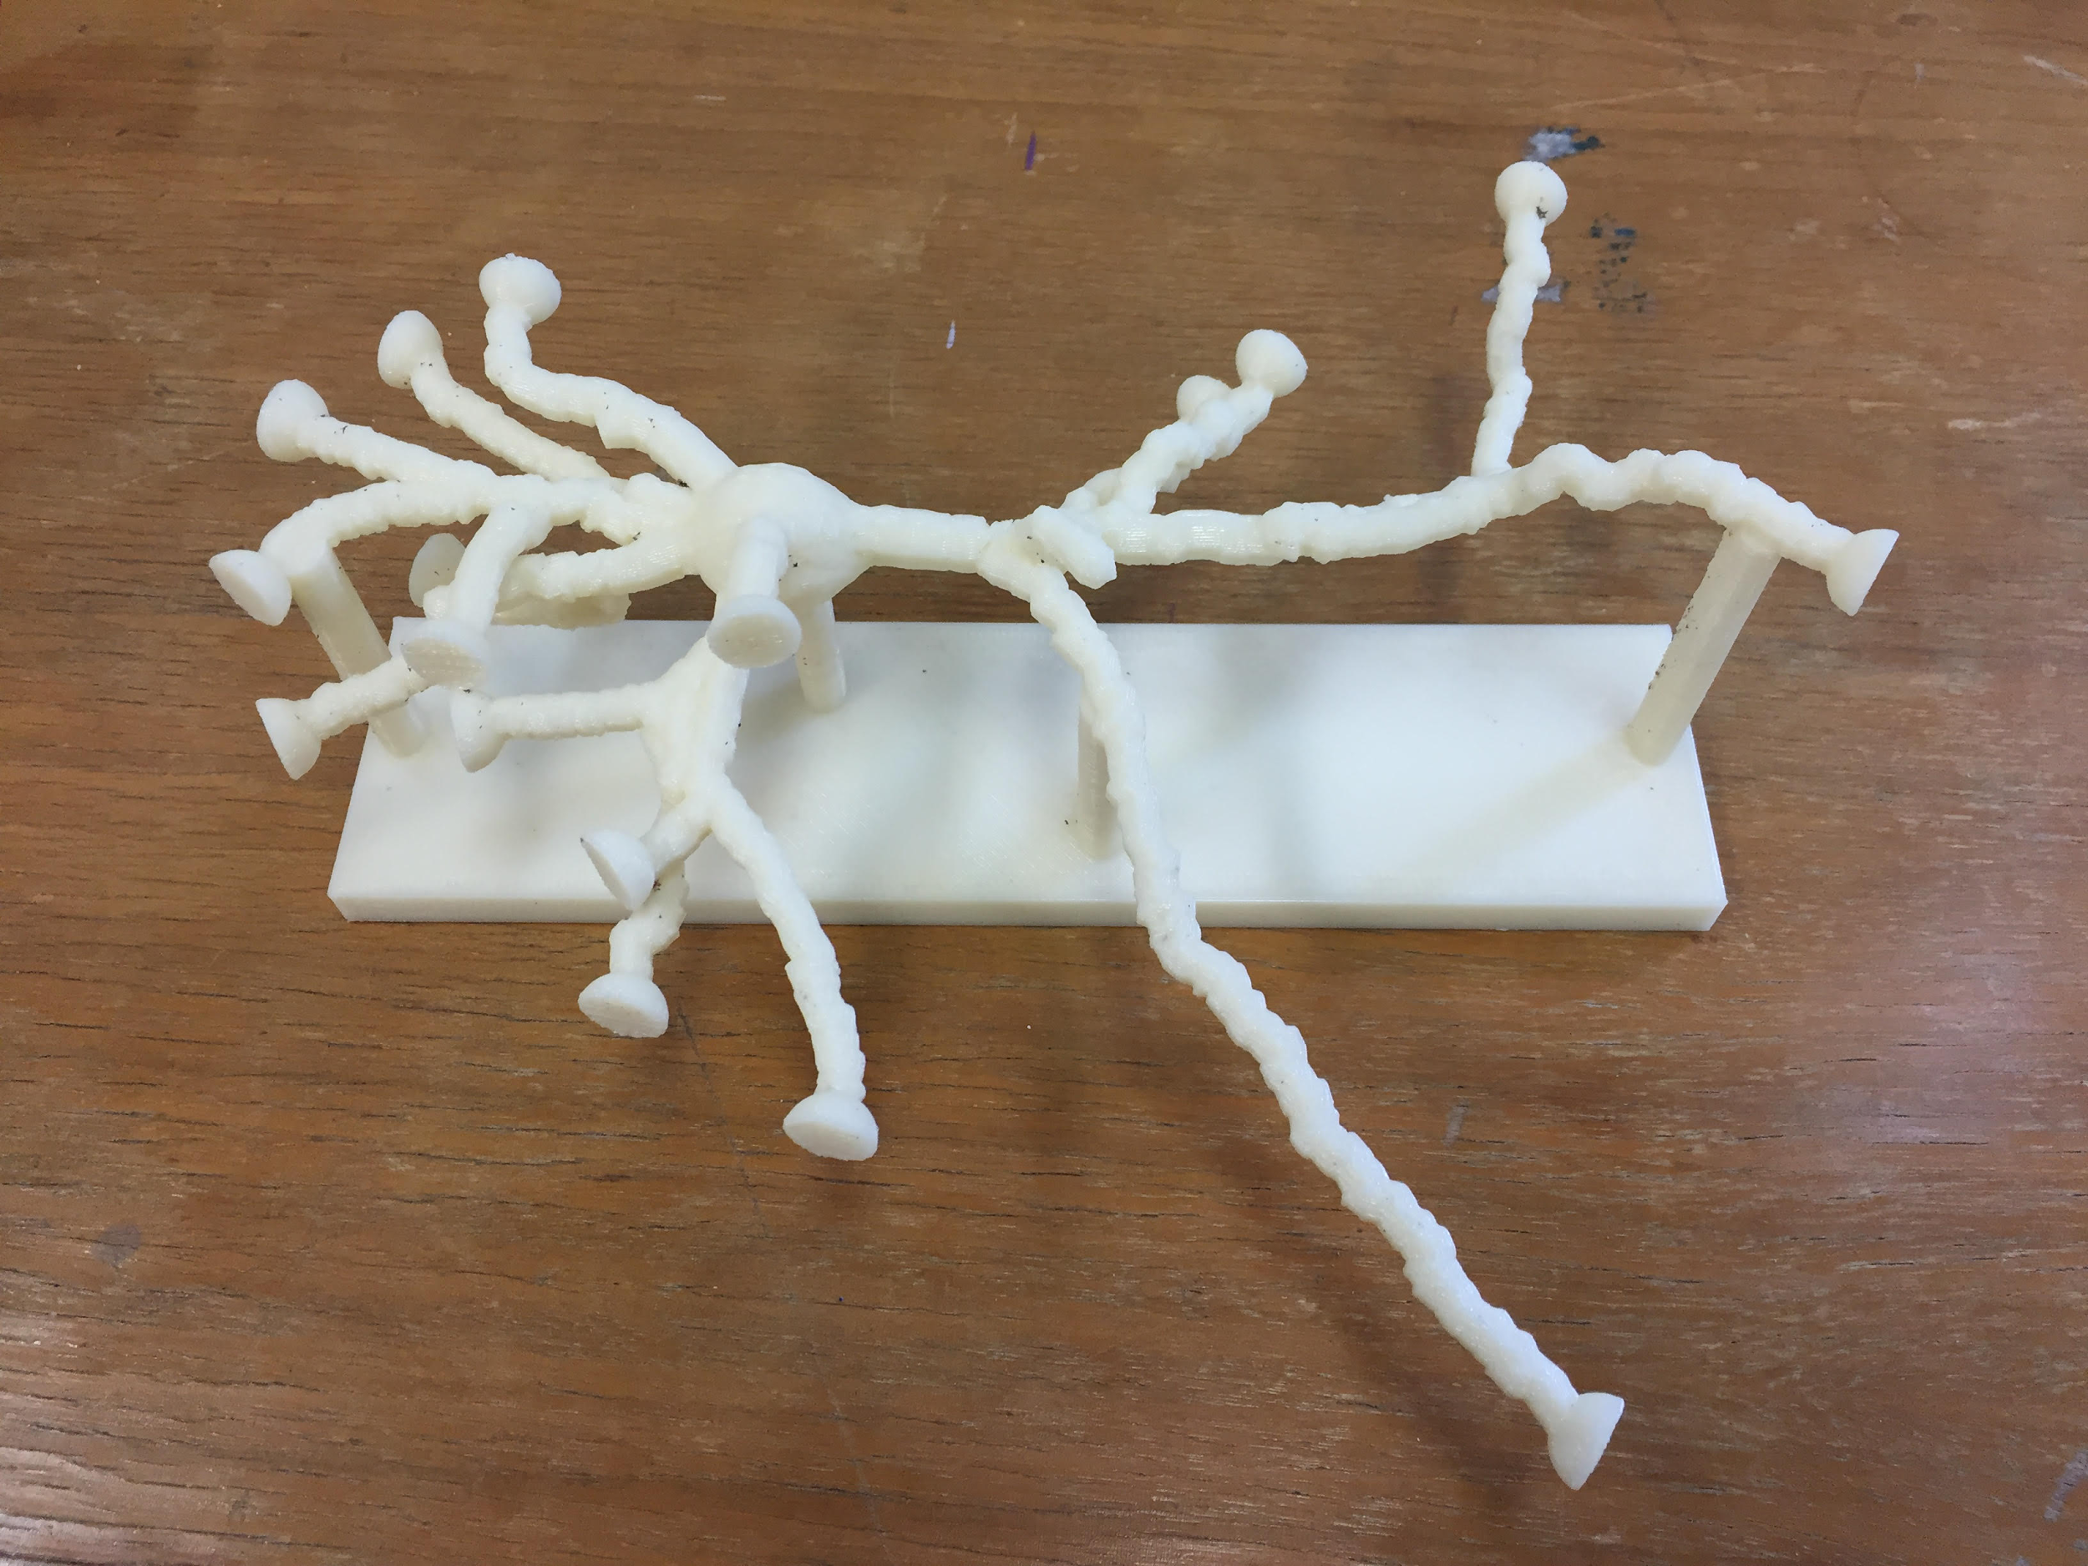
Neurons
Progression
3
1
2
4
5
6

Slide 14
Neurons
Issues
Difficulty finding neuron tracings that download
Variability in neurons
Quantity of neuron prints
Different sizes of Elite prints

Slide 15
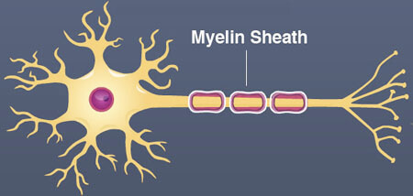
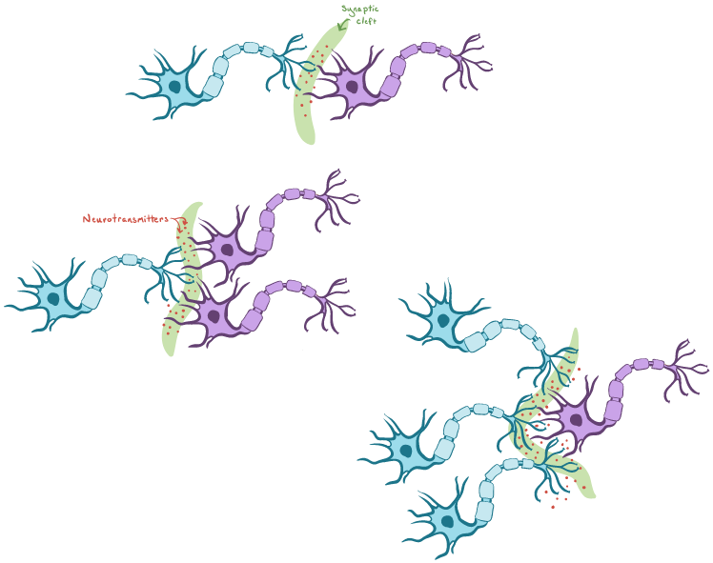
Neurons
Future Goals
Print with Stratays J750
Show myelin sheaths
Thermoplastic Polyurethane
Have more neuron types
Print more freely synapsing neurons
Print with conducting metal
Show electrical impulses

Slide 16
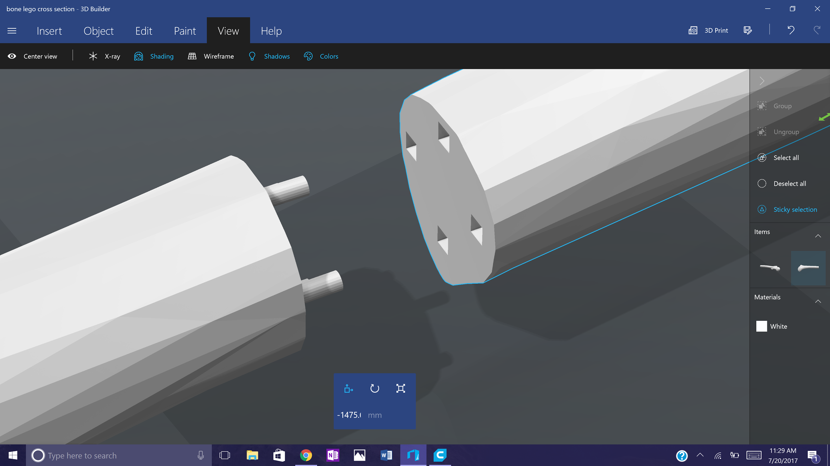
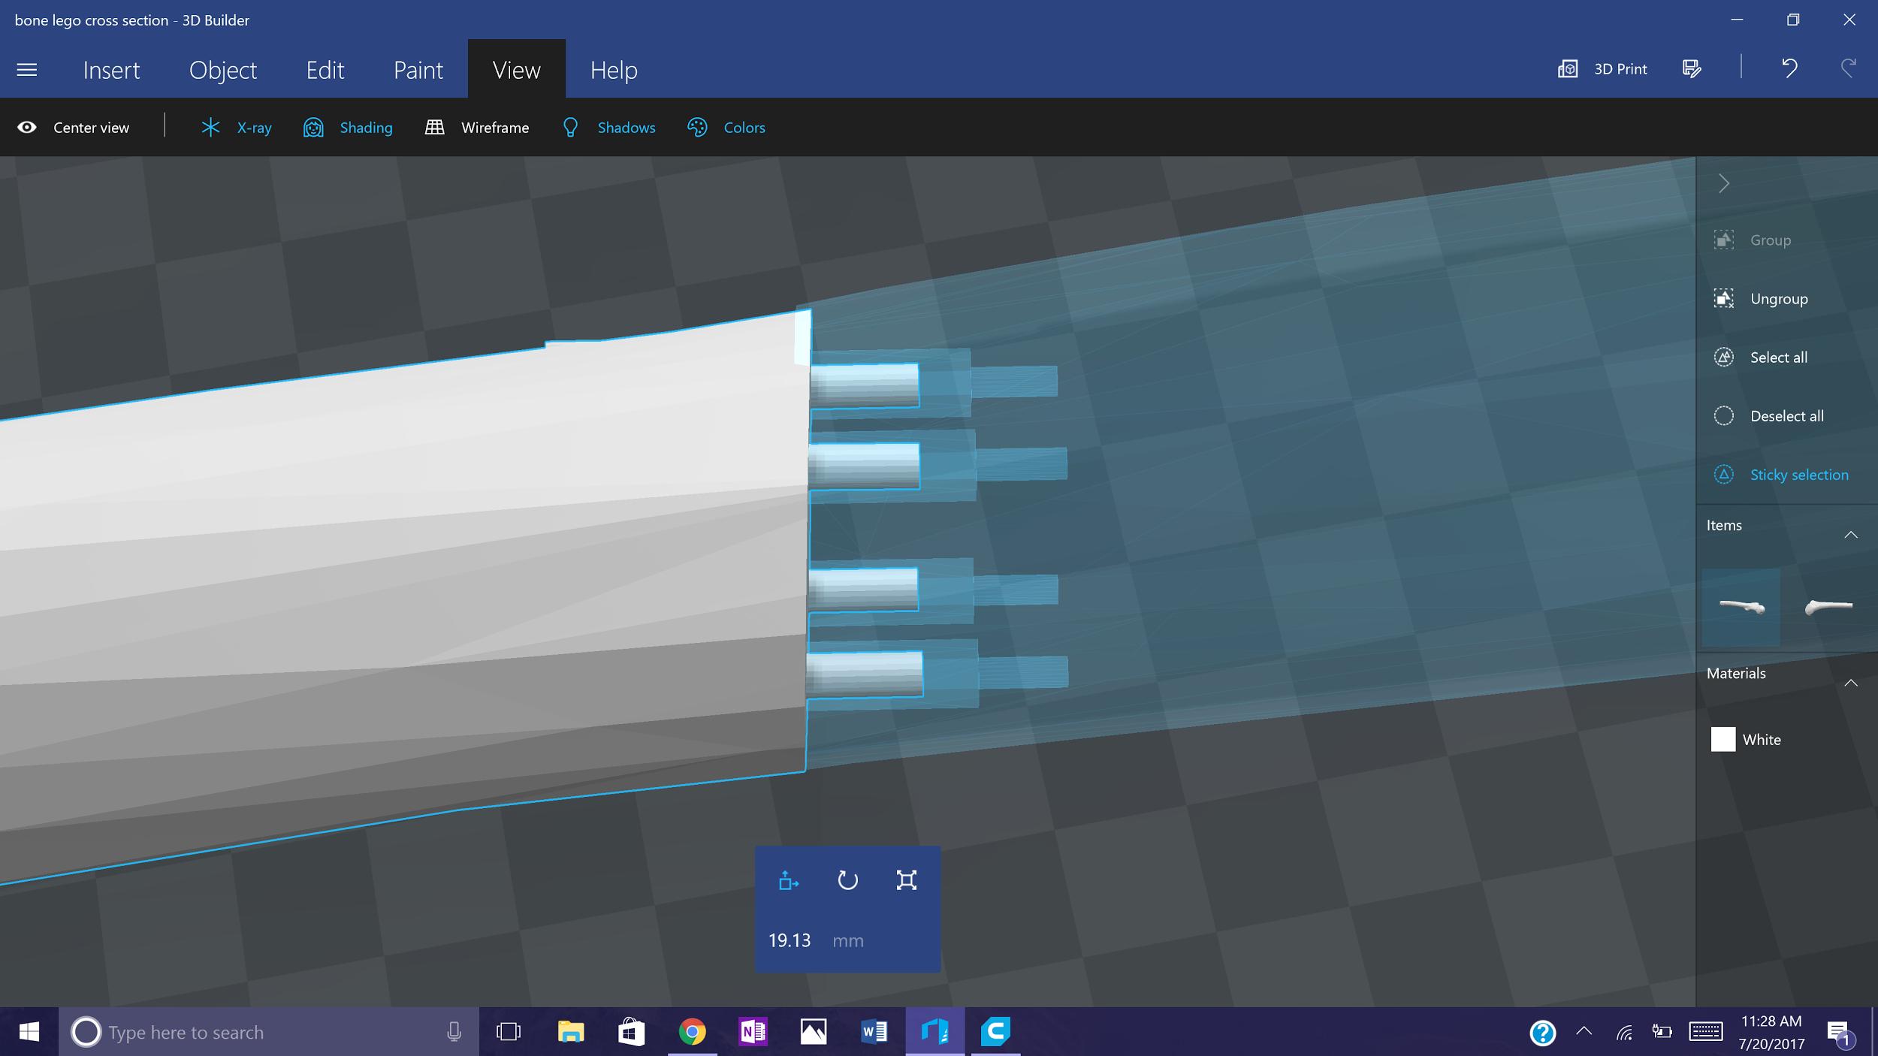
Bones Connection

Slide 17
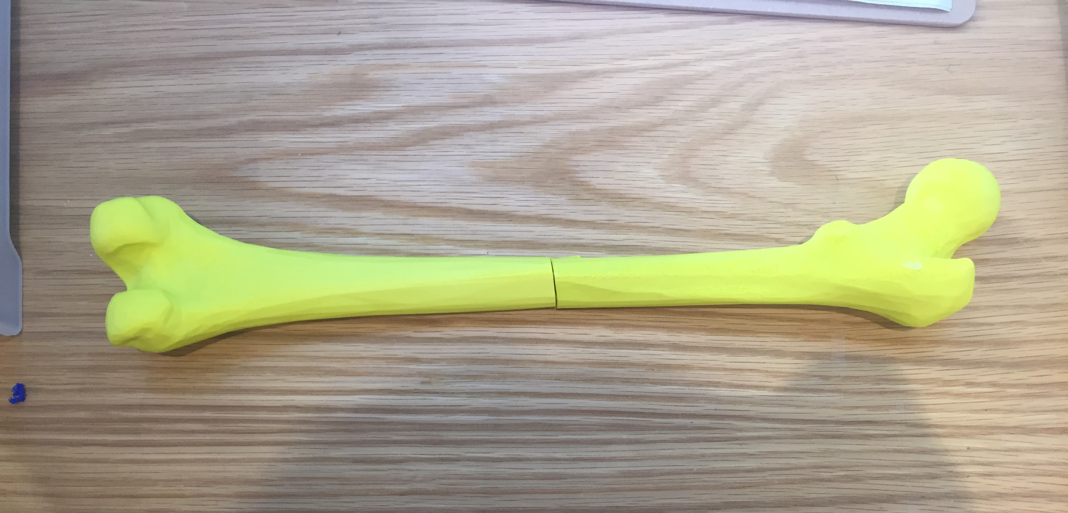
Bones Connection

Slide 18

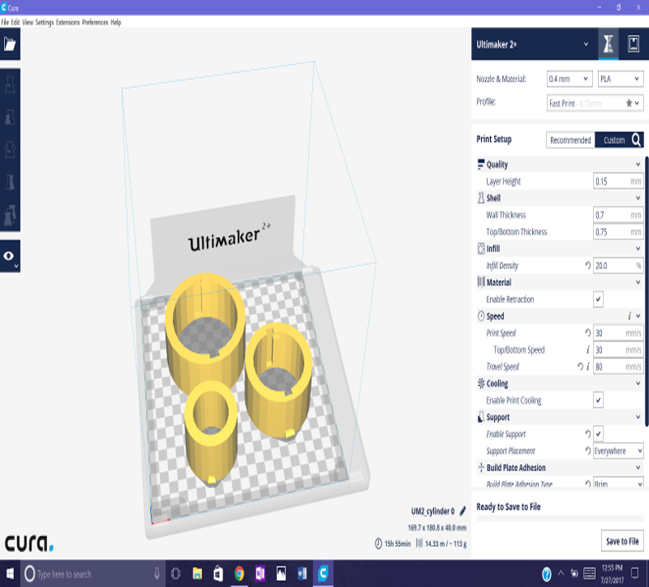
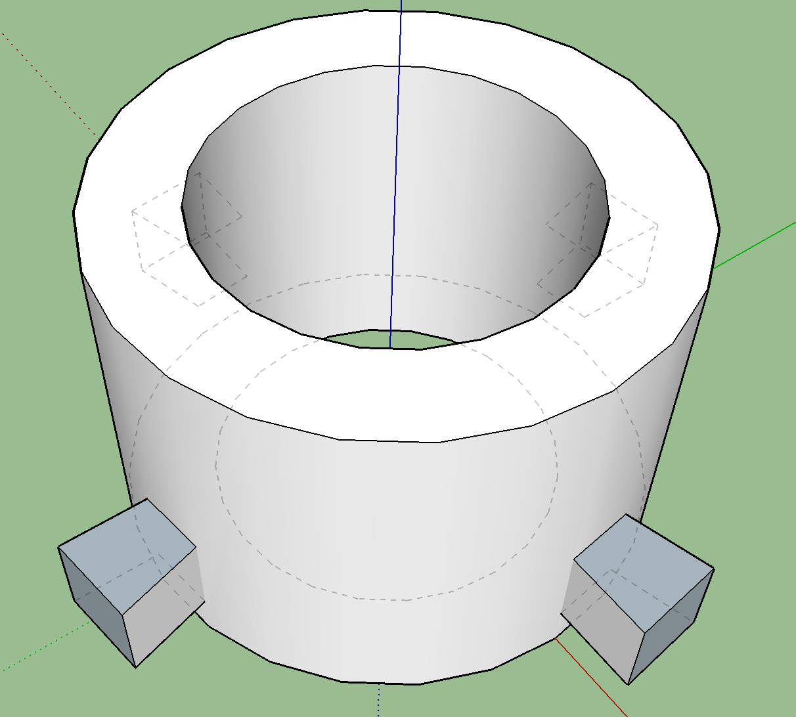
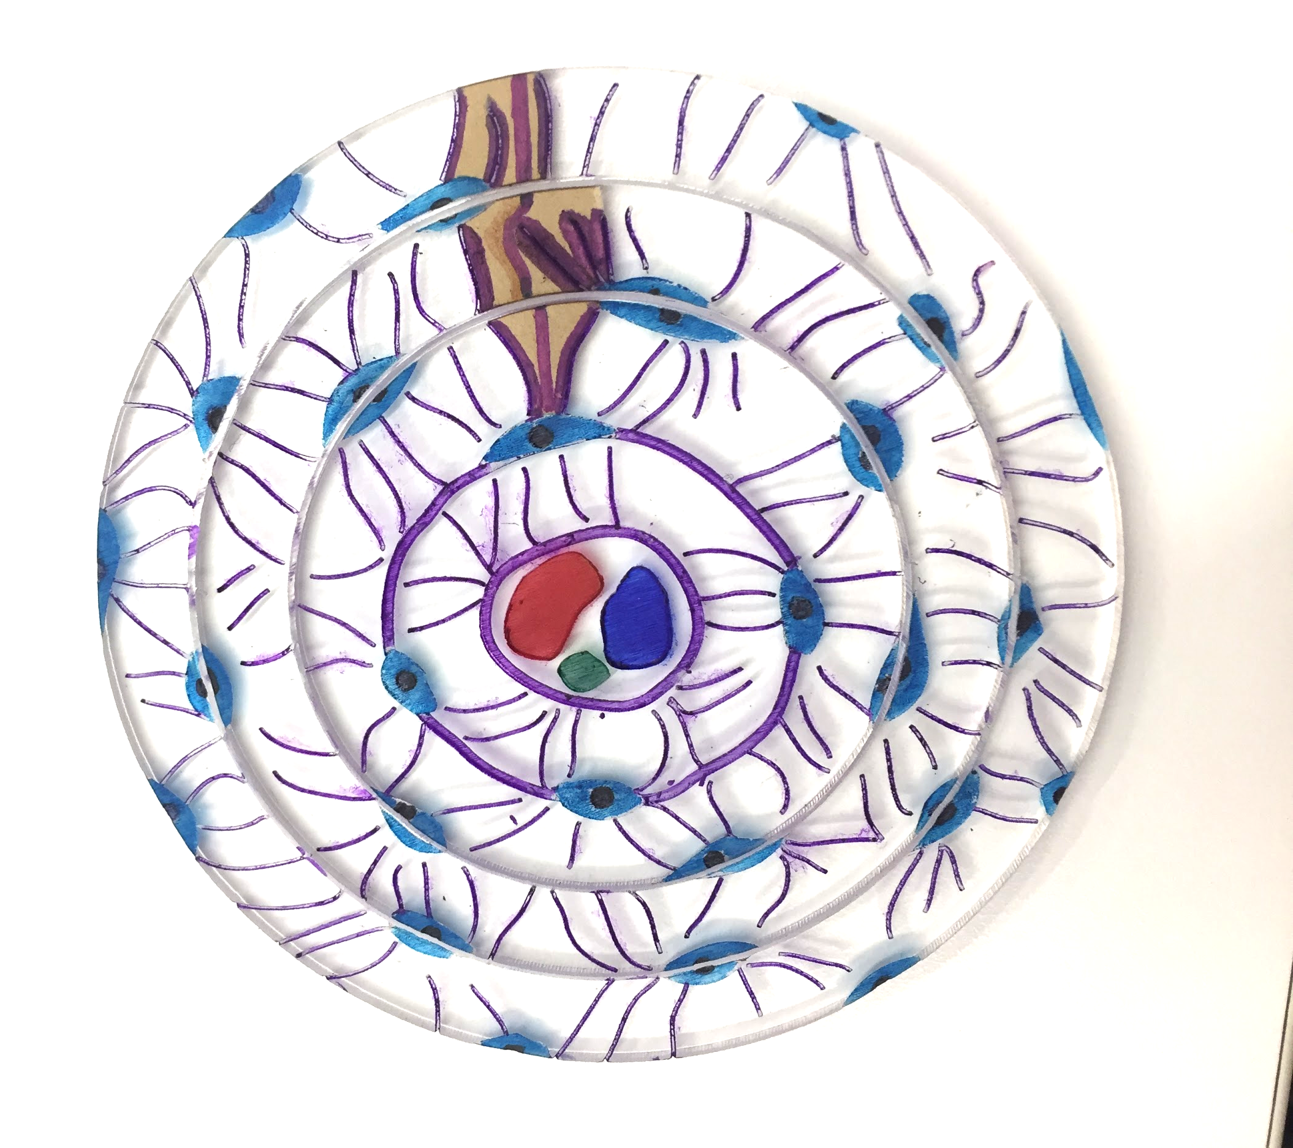
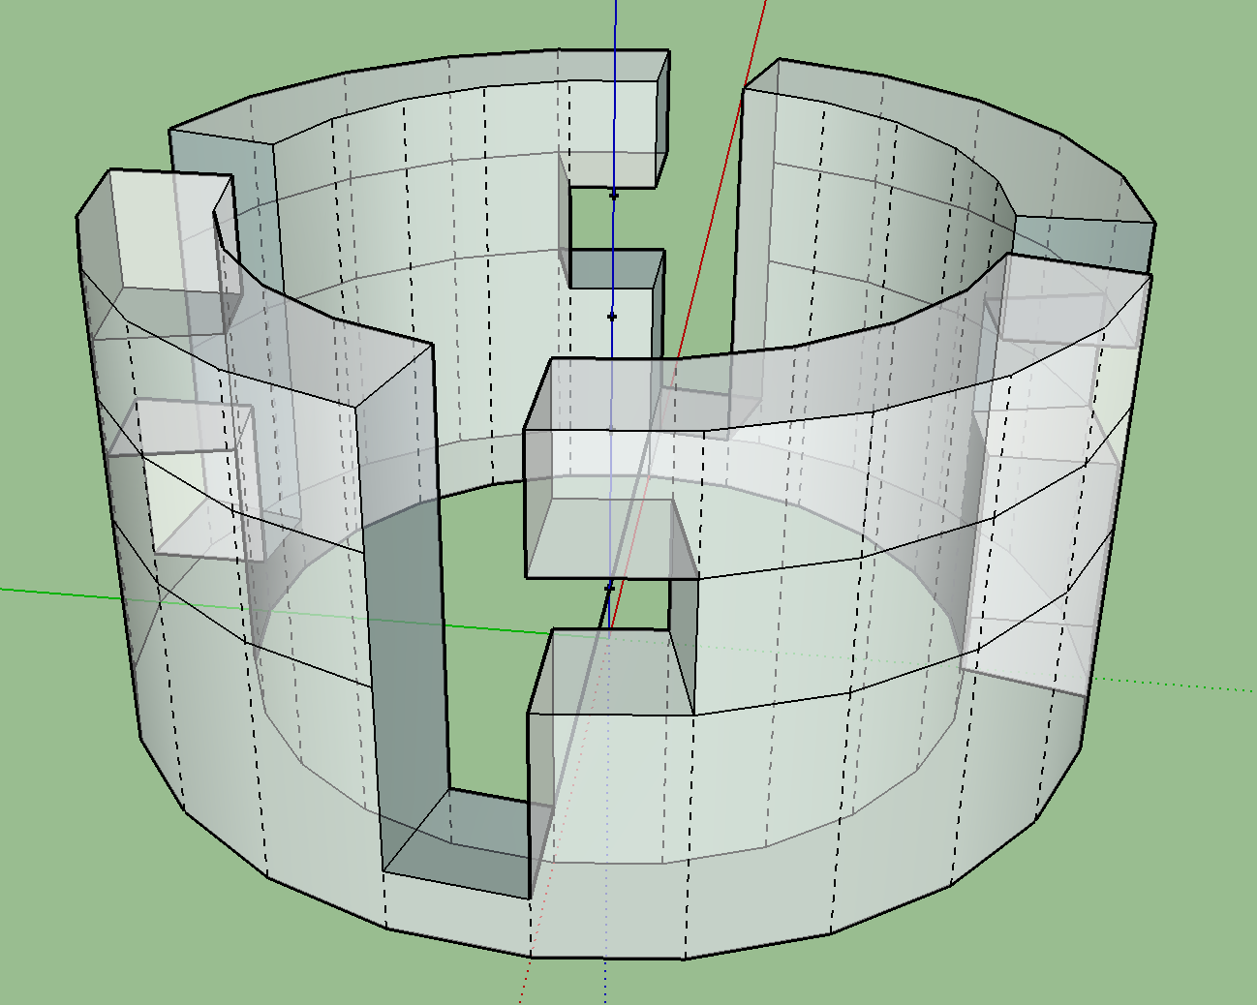
Bones (Osteons)
Built detachable concentric cylinders

Slide 19
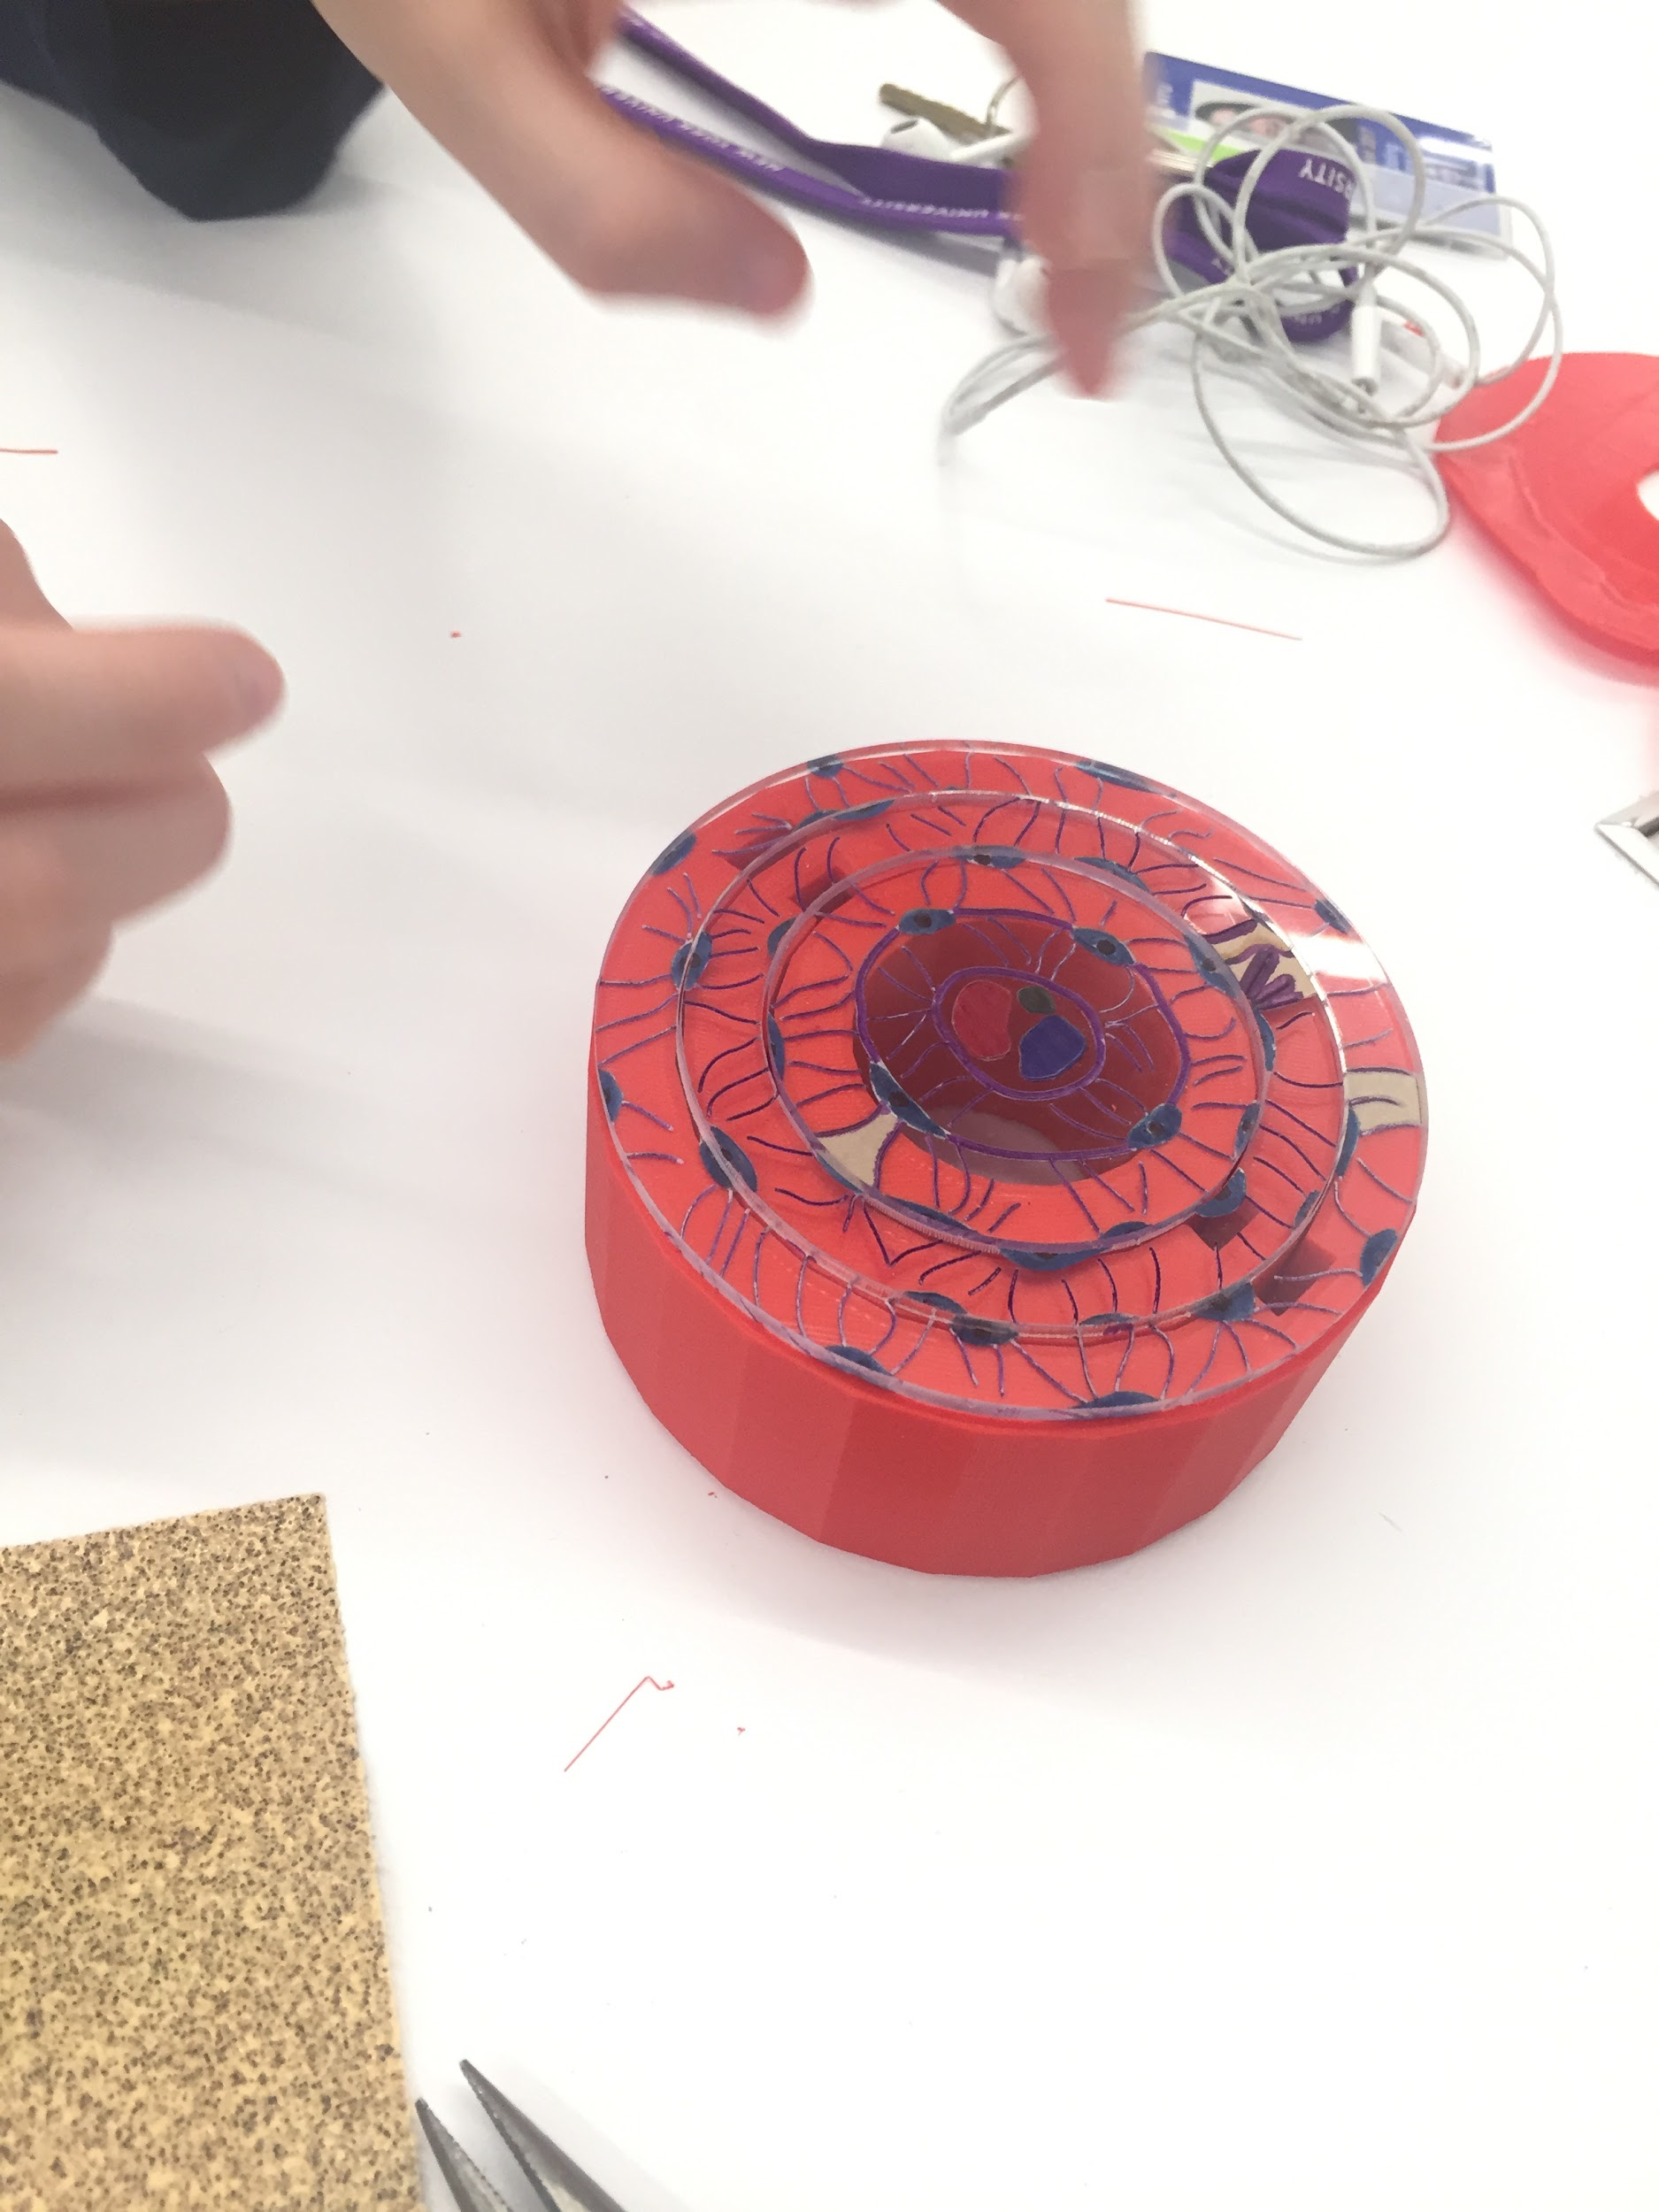
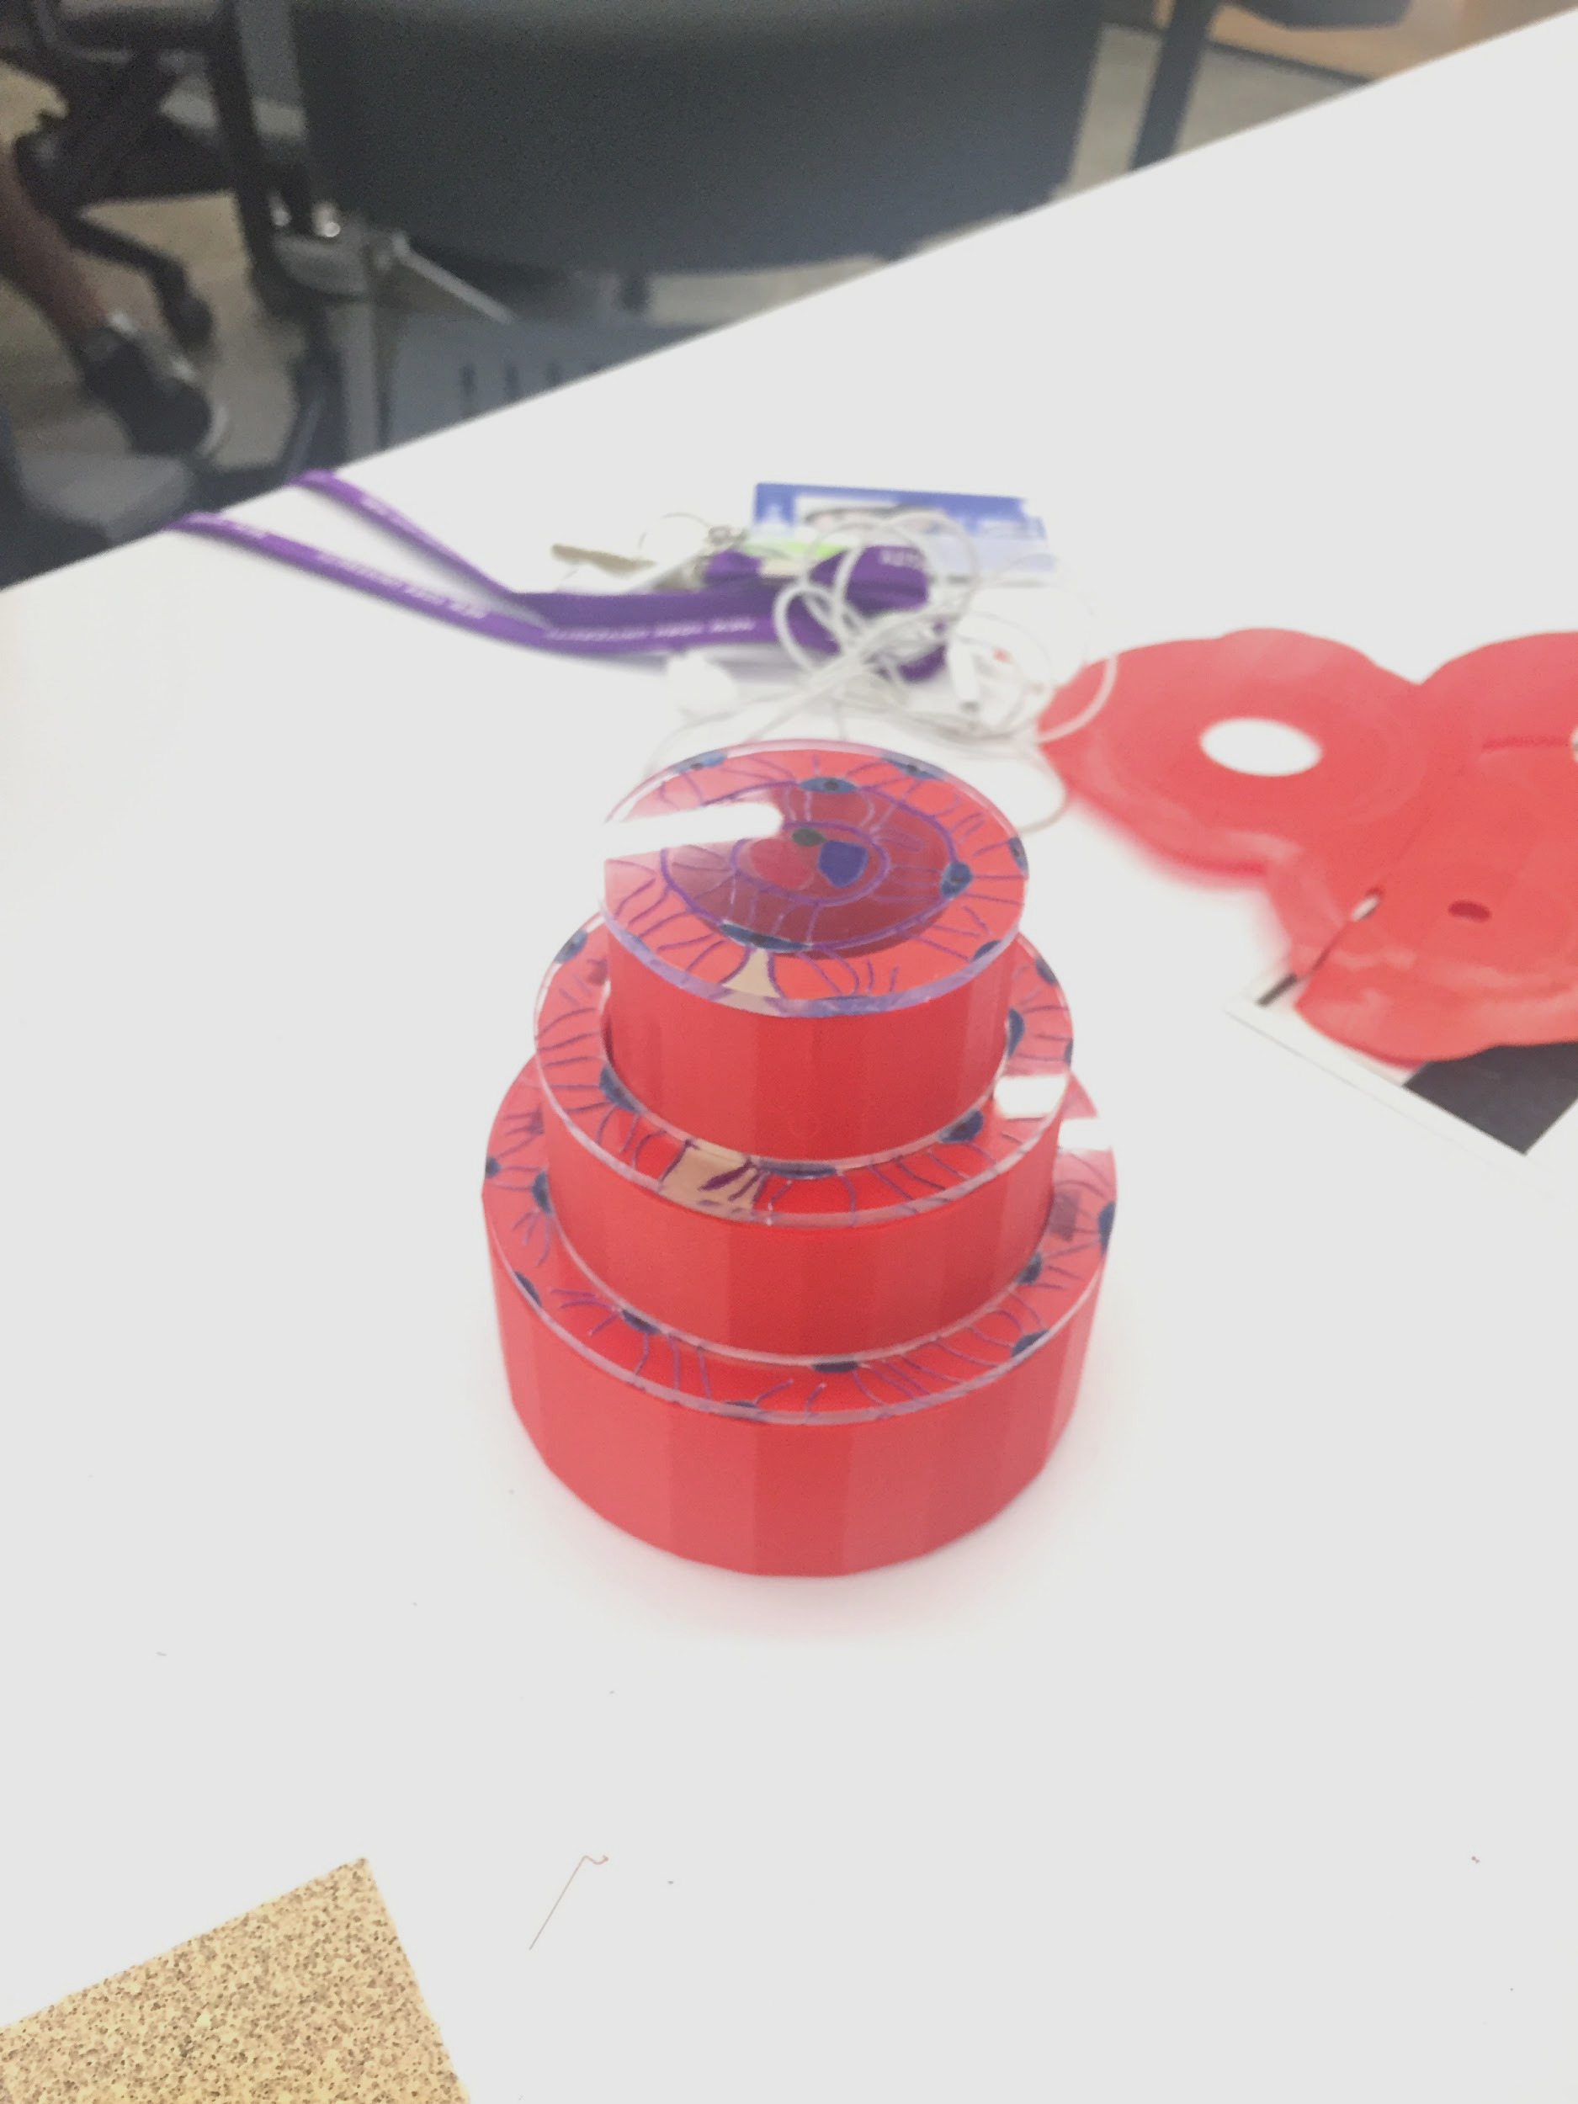
Bones (Osteons)

Slide 20
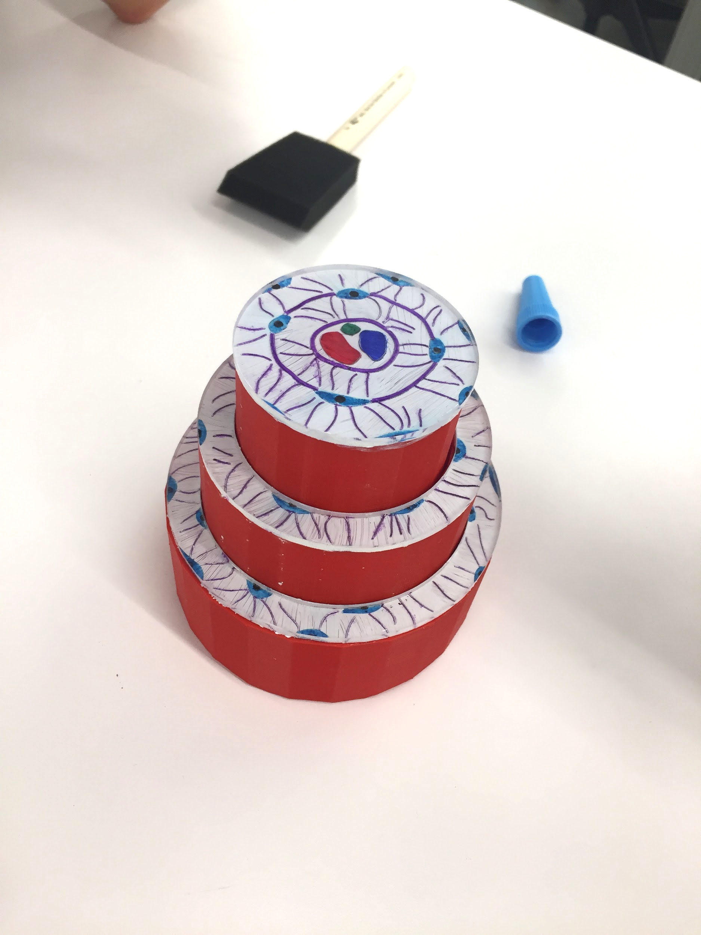
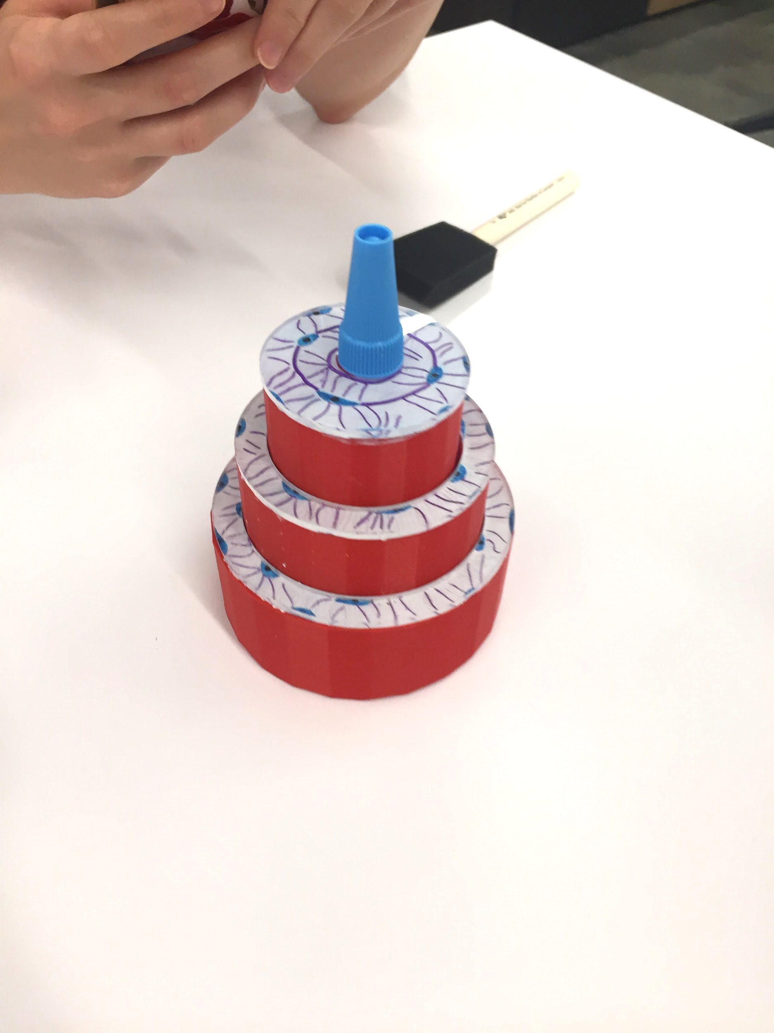
Bones (Osteons)

Slide 21
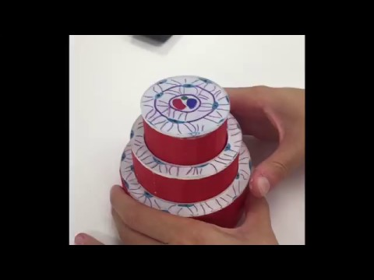
Bones (Osteons)

Slide 22
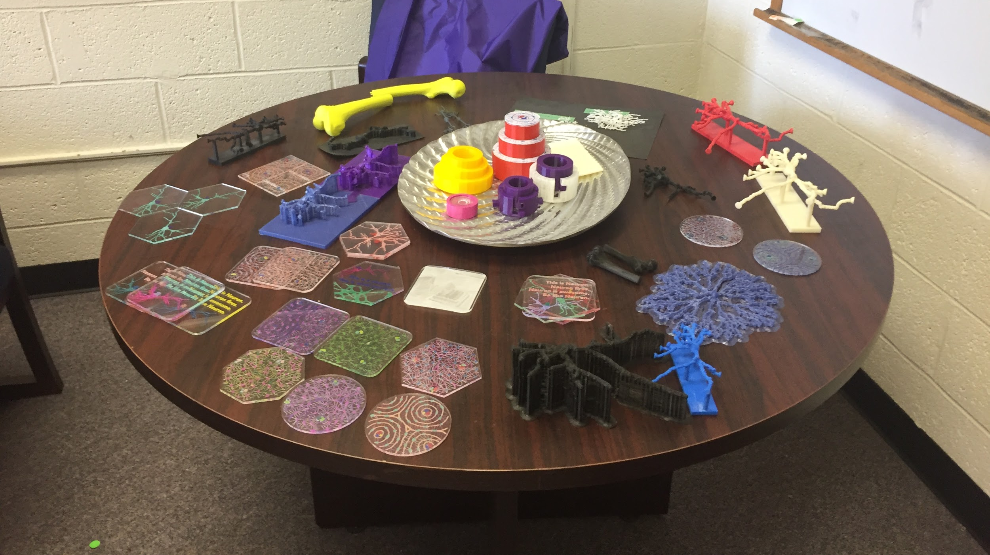
Future Tasks
Print a set of movable osteon cylinders
Show the organization of osteons
Make a more precise bone connection
Fill the table

Slide 23
Questions
Suggestions?

Slide 24
Thank you all
for your attention!

